Slide 1
COMPAIR D5.1
Guide to Air Quality Monitoringy

Slide 2
Disclaimer
This training was developed for the H2020 CompAIR project.
The training is meant for educational purposes related to air quality experiments with citizens.
The CompAIR pilot’s can use these slides to educate the people who will participate in their pilot. A subset of slides may be selected as not all content might be of use for every pilot. Pilots are also encouraged to adapt the slides to their specific needs (e.g. a map with air quality in Europe is presented in the slides, but a regional map will provide much more specific information for the pilots).

Slide 3
COMPAIR D5.1
Guide to Air Quality Monitoring
Chapter 1: Air quality training

Slide 4
Content
Introduction
What is air?
How is air quality changing over time?
High pollution episodes with high concentrations (smog, …) but in general improving quality
More evidence on health effects -> limit values are reduced
NO2, PM, BC relevant pollutants + measured in CompAIR
Per pollutant
What is it?
Sources
Health impact
Situation in EU
Environmental impact
Meteo
Transportation
Street canyons

Slide 5
Introduction
More information on: Together for Clean Air

Slide 6
What is air?
Air:
78% nitrogen (N₂) + 21% oxygen (O₂)+ 0,9% argon (Ar)
0,1% other
0,04% CO₂ (=400 ppm)
Particulate Matter (PM), nitrogen dioxide (NO₂)
O₃, CO, SO₂,VOC, heavy metals, PAH’s, dioxins,
Black carbon (BC), ultra fine particles (UFP), NH₃…
The quality of our air is depending on <1% of its content (micrograms & nanograms/m³)
Notes:
PPM = One part per million (ppm) denotes one part per 1,000,000 parts
1PPB (0.001PPM) equals 1.88 µg/m3 for NO2 VOC = volatile organic compound (use of fossil fuels, solvents, etc.) -> irritation, headache, nausea, … PAH = polycyclic aromatic hydrocarbon (wood burning, combustion of biofuels, etc.) -> carcinogenic

Slide 7
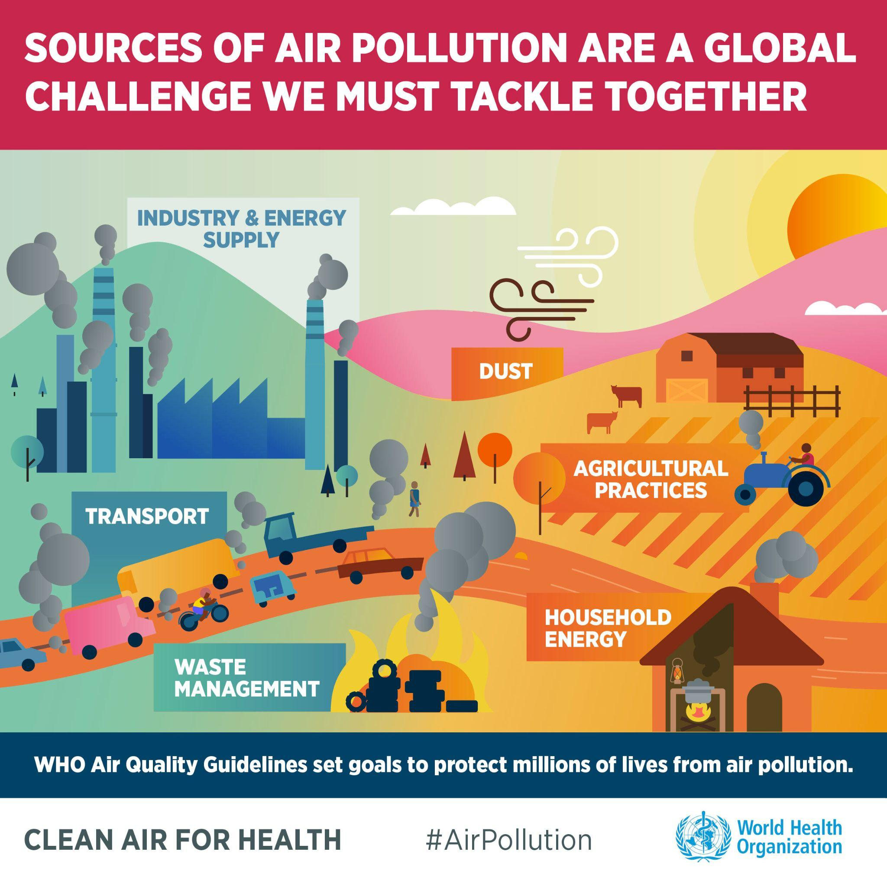
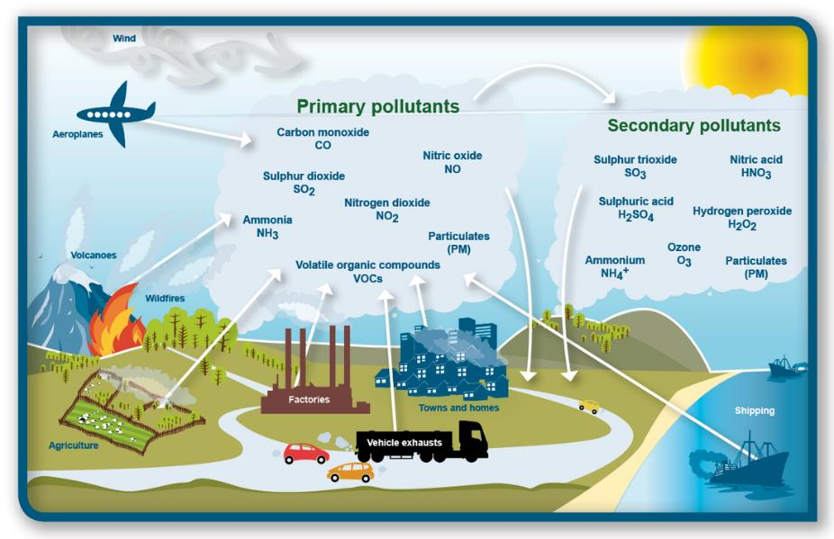
Many pollutants, many sources
Notes:
Primary pollutants are emitted directly by a source. Secondary pollutants are formed by interactions in the atmosphere.

Slide 8
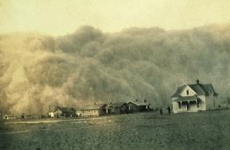
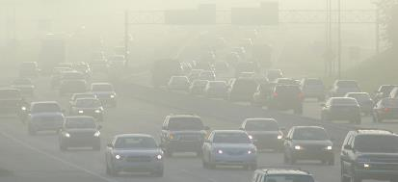
Negative episodes
Total dust London 1700-2016
Peak second half 19th century
Smog episodes
Notes:
Smog is a mixture of smoke, gases and chemicals, especially in cities. It makes the atmosphere difficult to breathe and is harmful for our health.
First very known smog episode, London smog in 1953, when a lot of people died was a combination of pollution and bad weather conditions

Slide 9
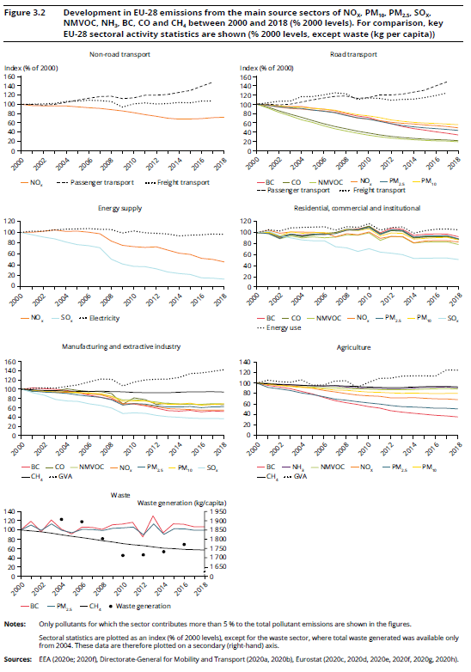
BUT in general air quality is improving
Source: European Environment Agency, Air quality in Europe - 2020 report
Notes:
The EU has been working for decades to improve air quality by controlling emissions of harmful substances into the atmosphere, improving fuel quality, and integrating environmental protection requirements into the transport, industrial and energy sectors. Air quality plans and measures to reduce air pollutant emissions and improve air quality have been implemented throughout Europe and form a core element in air quality management.
The abatement measures implemented at the national level have addressed the whole set of emissions sectors, for example:
road traffic: low-emission zones, switching to cleaner public transport such as low-emission buses or trams, promoting cycling and walking, car-sharing schemes, lowering speed limits and issuing congestion charges;
residential heating: expanding district heating, using cleaner fuels for heating, reducing energy use via insulation of buildings, use of energy certification system/labelling;
inland shipping;
industry: implementation of the requirements of the Integrated Pollution Prevention and Control (IPPC) Directive;
construction and demolition activities, including emissions from non-road mobile machinery

Slide 10
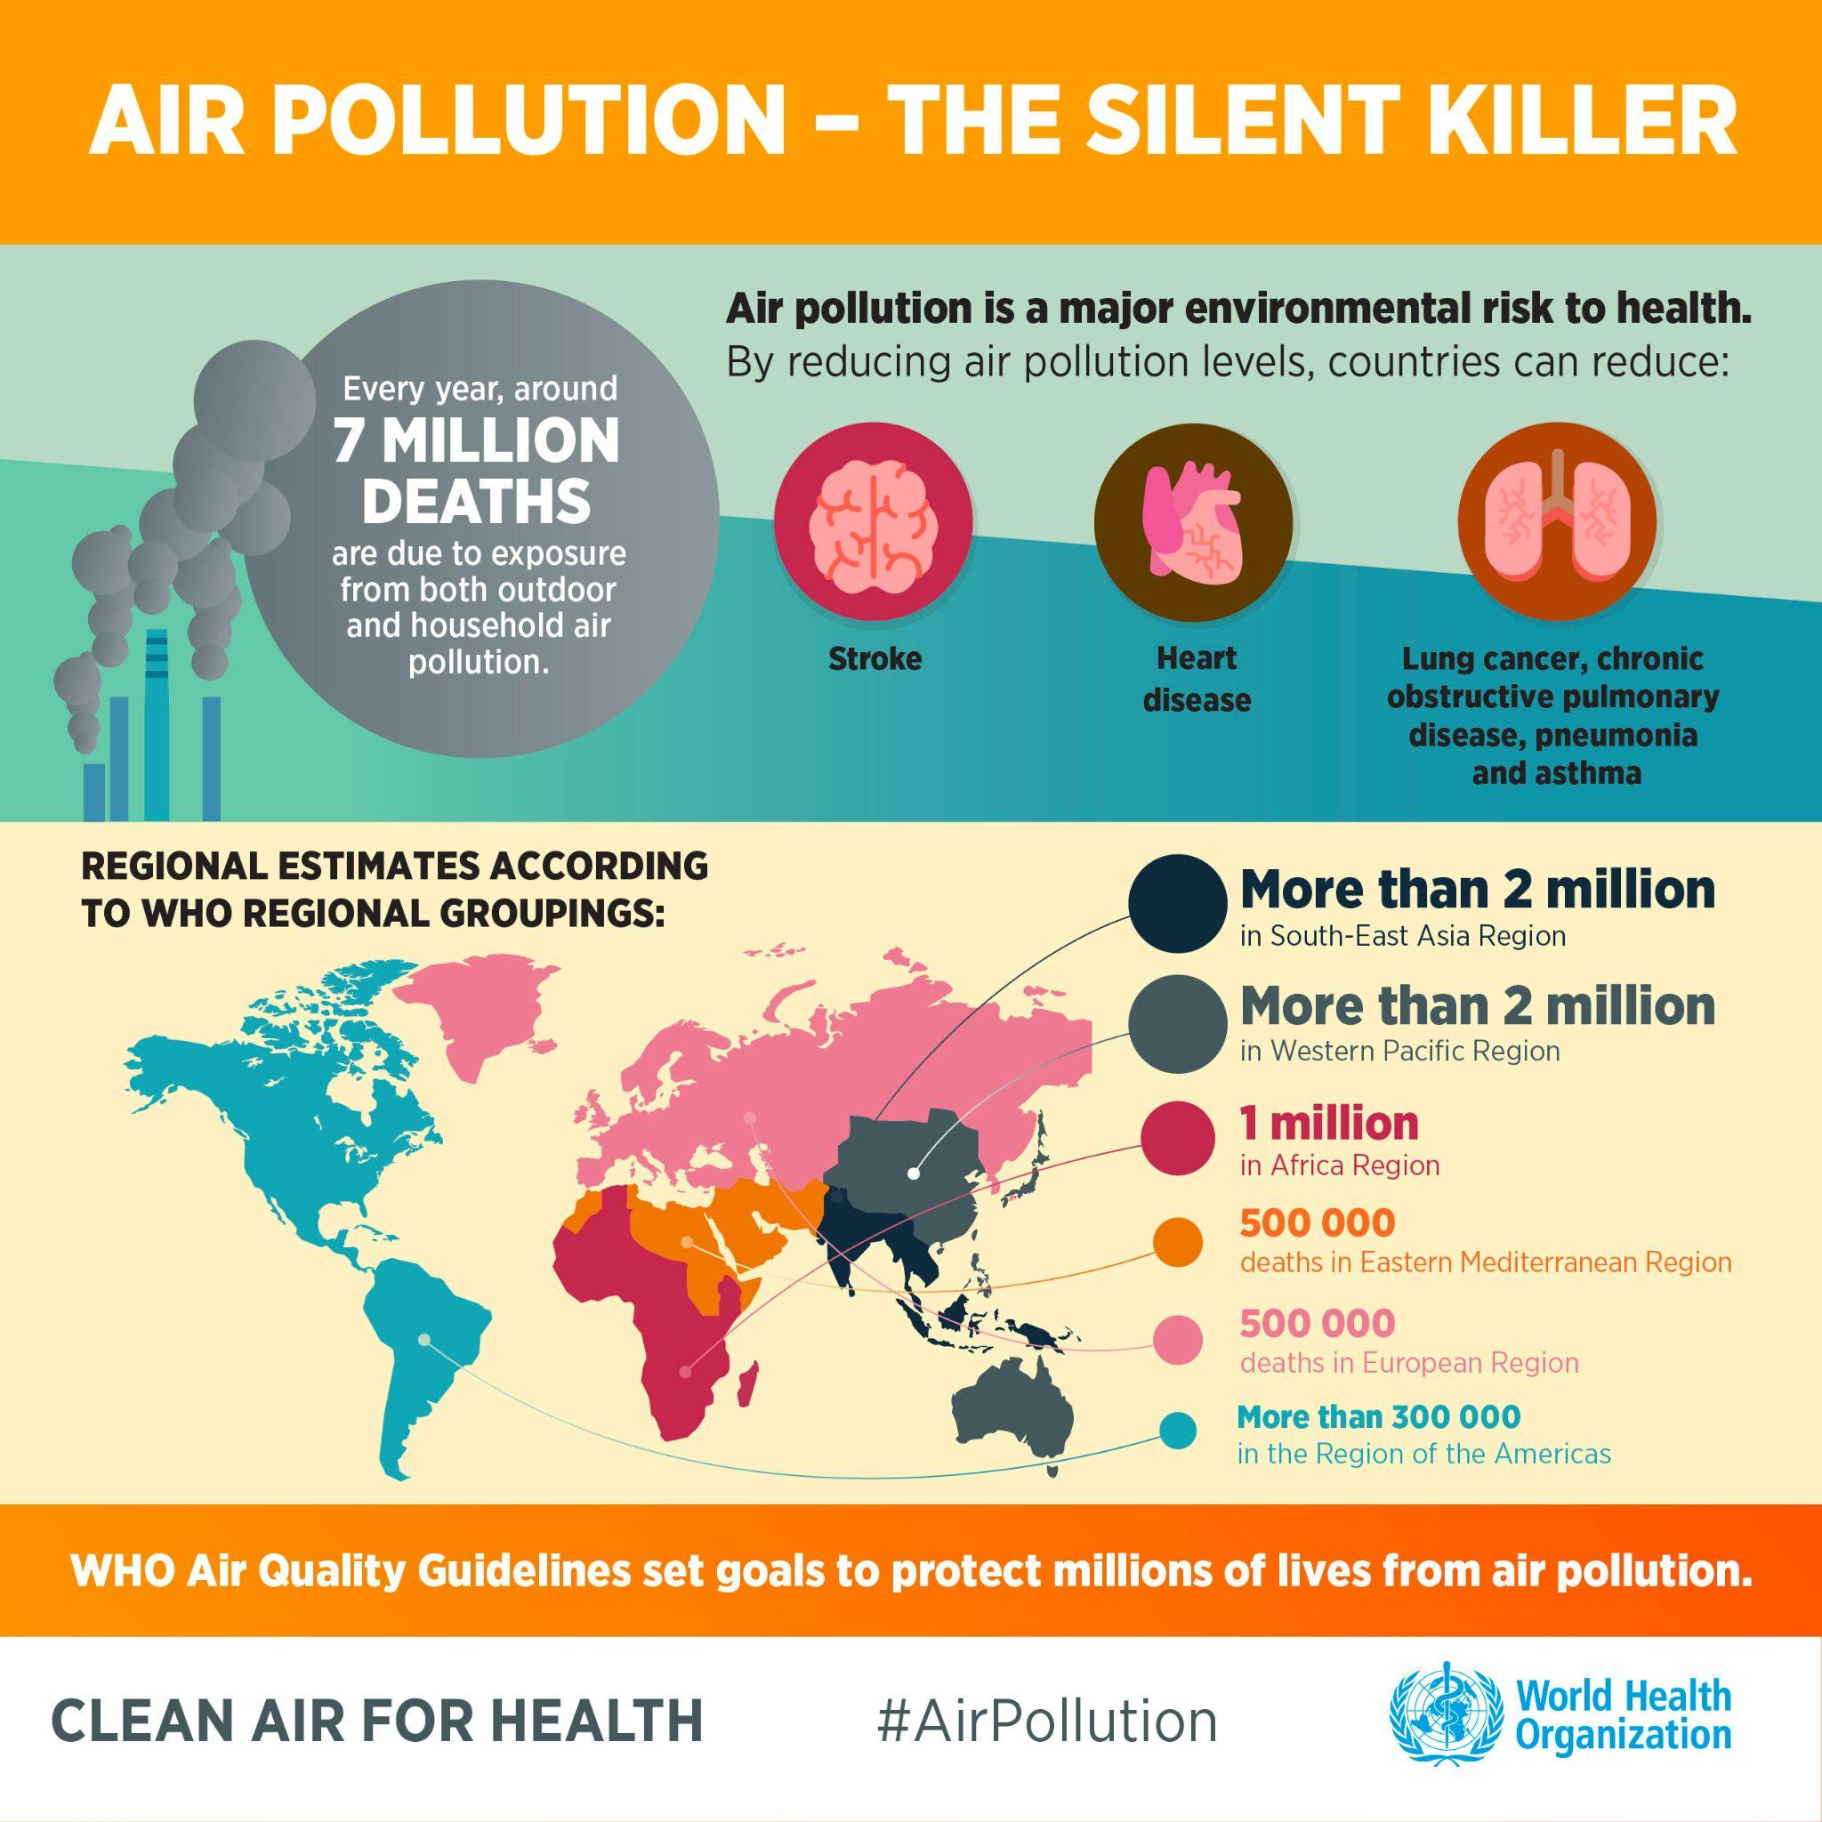
Health effects more clear

Slide 11
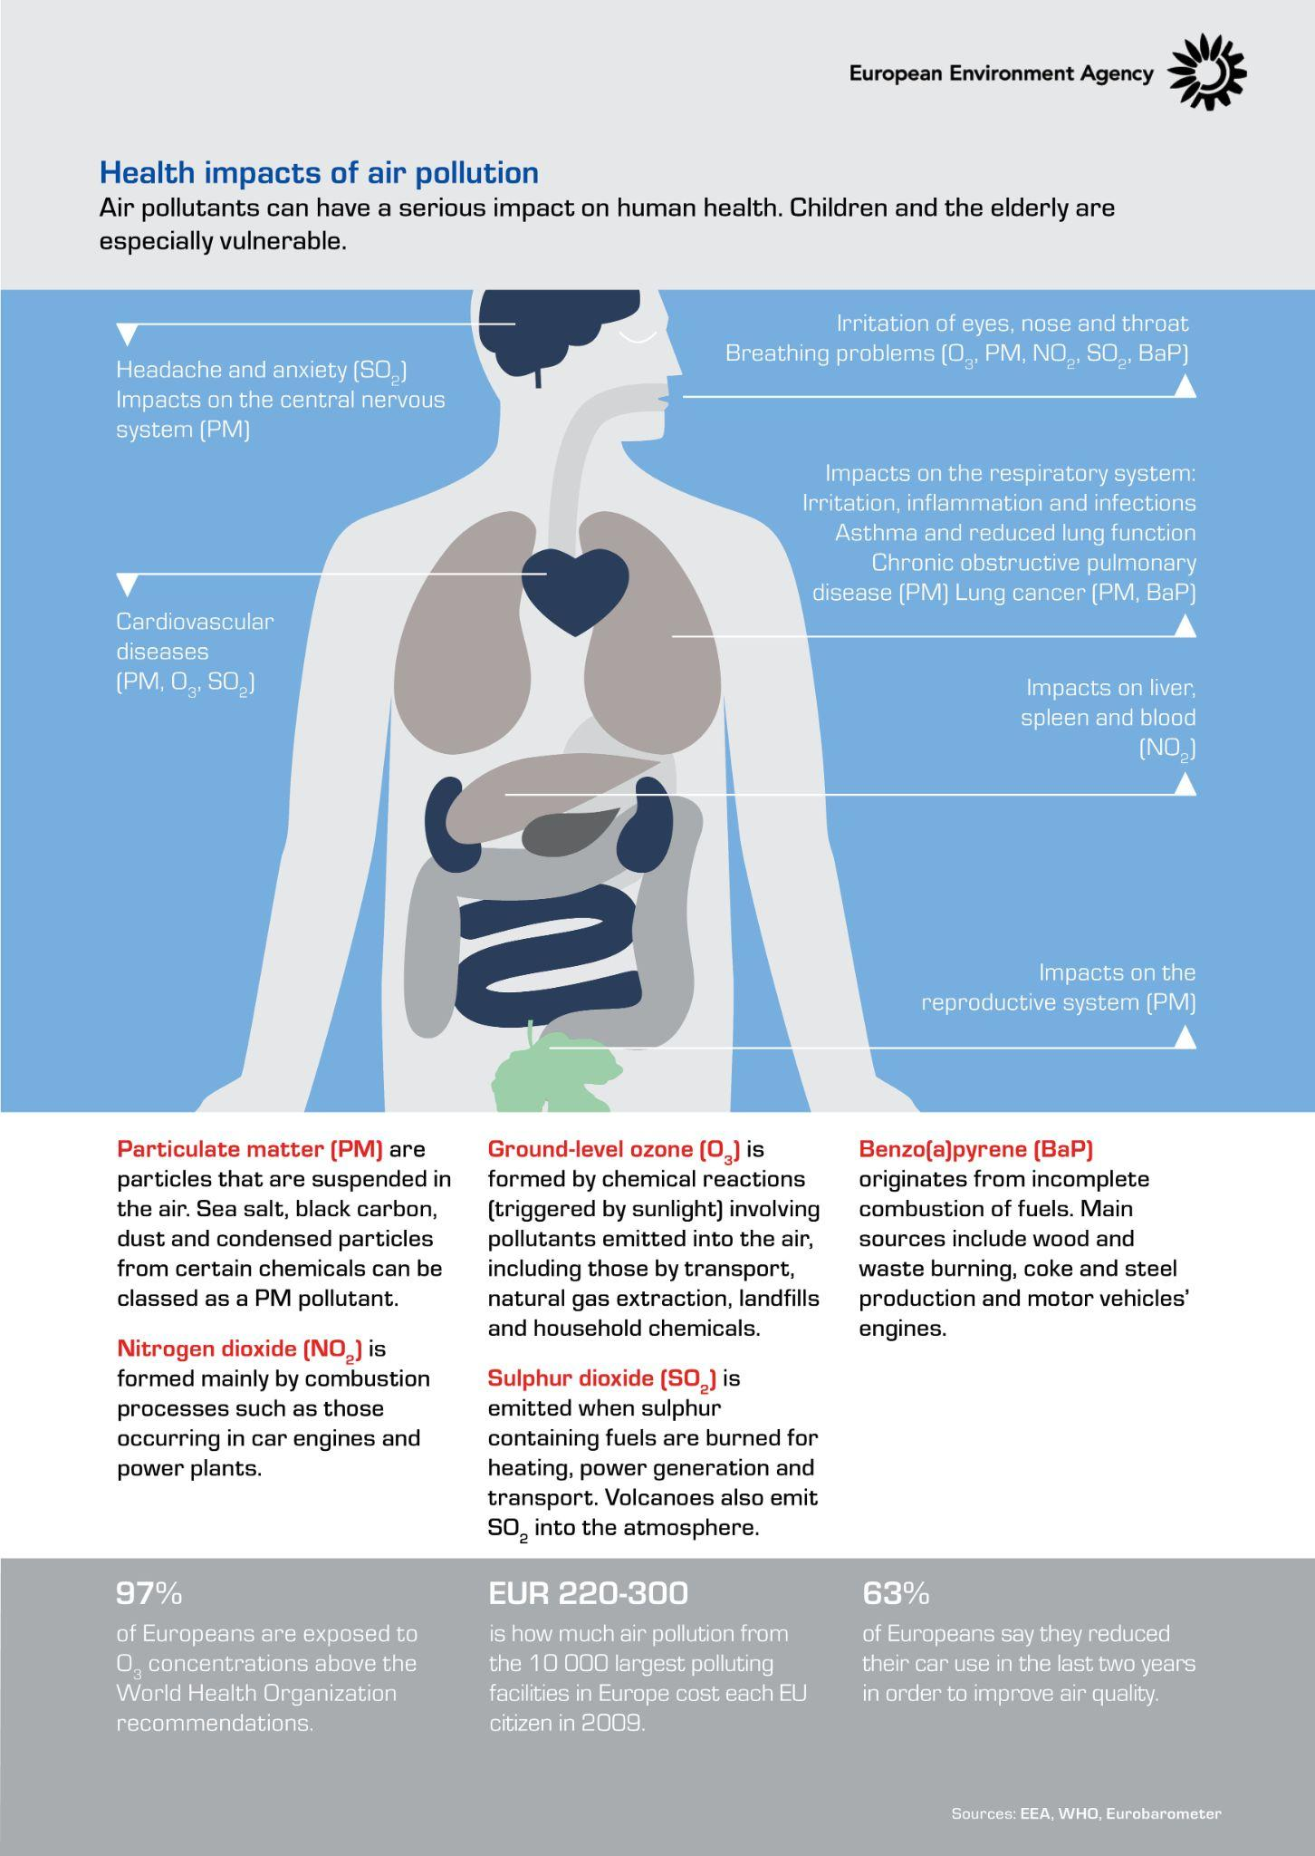
Health effects more clear

Slide 12
Health effects more clear

Slide 13
Limit values (EU) and WHO guidelines- yearly
PM_{2.5}
0
10
20
30
40
50
µg/m³
NO₂
Notes:
Limit values are legally binding parameters that must not be exceeded. Limit values are set for individual pollutants and are made up of a concentration value, an averaging time over which it is to be measured, the number of exceedances allowed per year, if any, and a date by which it must be achieved.

Slide 14
Limit values (EU) and WHO guidelines
Fine dust (PM₁₀) | yearly average < 40 µg/m³ | yearly average < 15 µg/m³
 | daily average max 35 x > 50 µg/m³ | day max 3 x > 45 µg/m³
Fine dust (PM_{2,5}) | yearly average < 25 µg/m³ | yearly average < 5 µg/m³ day max 3 x > 15 µg/m³
Nitrogen dioxide (NO₂) | yearly < 40 µg/m³ | yearly < 10 µg/m³
Notes:
Note that for PM10 the daily average maximals can be exceeded 35 times a year according to the EU limit values and only 3 times a year for the WHO limit values (https://www.who.int/news-room/fact-sheets/detail/ambient-(outdoor)-air-quality-and-health#:~:text=The%20current%20WHO%20guideline%20value,effects%20of%20gaseous%20nitrogen%20dioxide.)

Slide 15
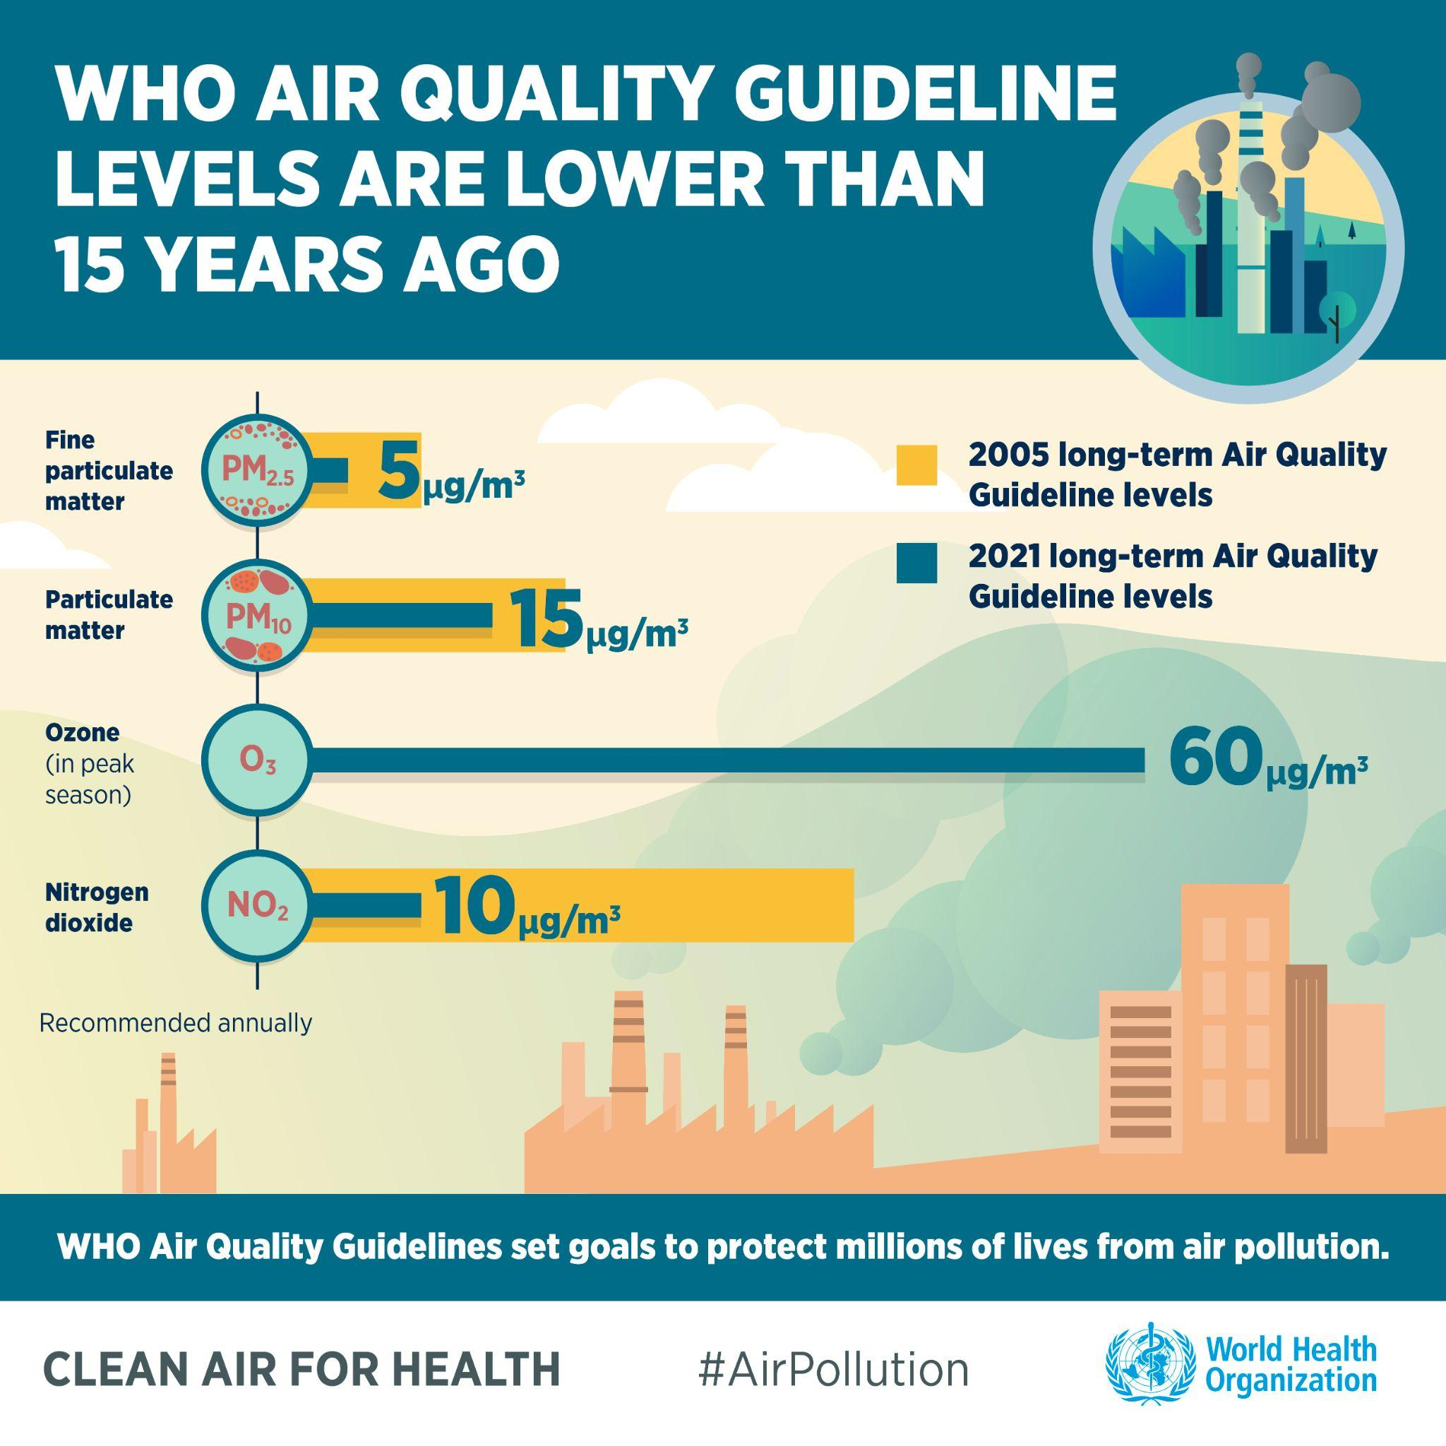
Limit values (EU) and WHO guidelines

Slide 16
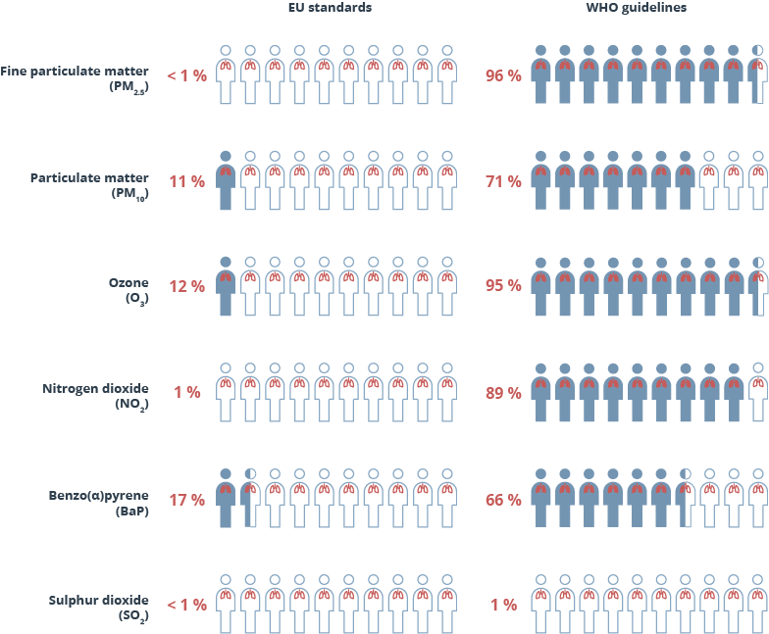
Limit values
Share of the EU urban population exposed to air pollutant concentrations above EU standards and WHO guidelines in 2020
Source: AIR003
Notes:
The World Health Organisation (WHO) introduced new Global Air Quality Guidelines (AQGs) on September 22, 2021. The new version of AQGs was developed on the already available threshold limits that were in place since 2005. The updated values provide clear evidence that poor air quality damages human health at even lower concentrations than were assumed previously. Note that due to the reduced concentrations of the air quality guidelines the percentage of the poppulation that is exposed to poor air quality is strongly increased.

Slide 17
Important pollutants
Pollutant | Premature deaths attributed (41 European countries) | Years of life lost (41 European countries)
PM_{2.5} | 417 000 | 55 000
NO₂ | 4 806 000 | 624 000
BC | NA | NA
Black Carbon is carcinogenic
Source: European Environment Agency, Air quality in Europe - 2020 report

Slide 18
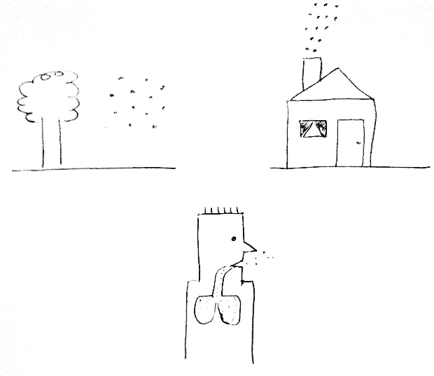
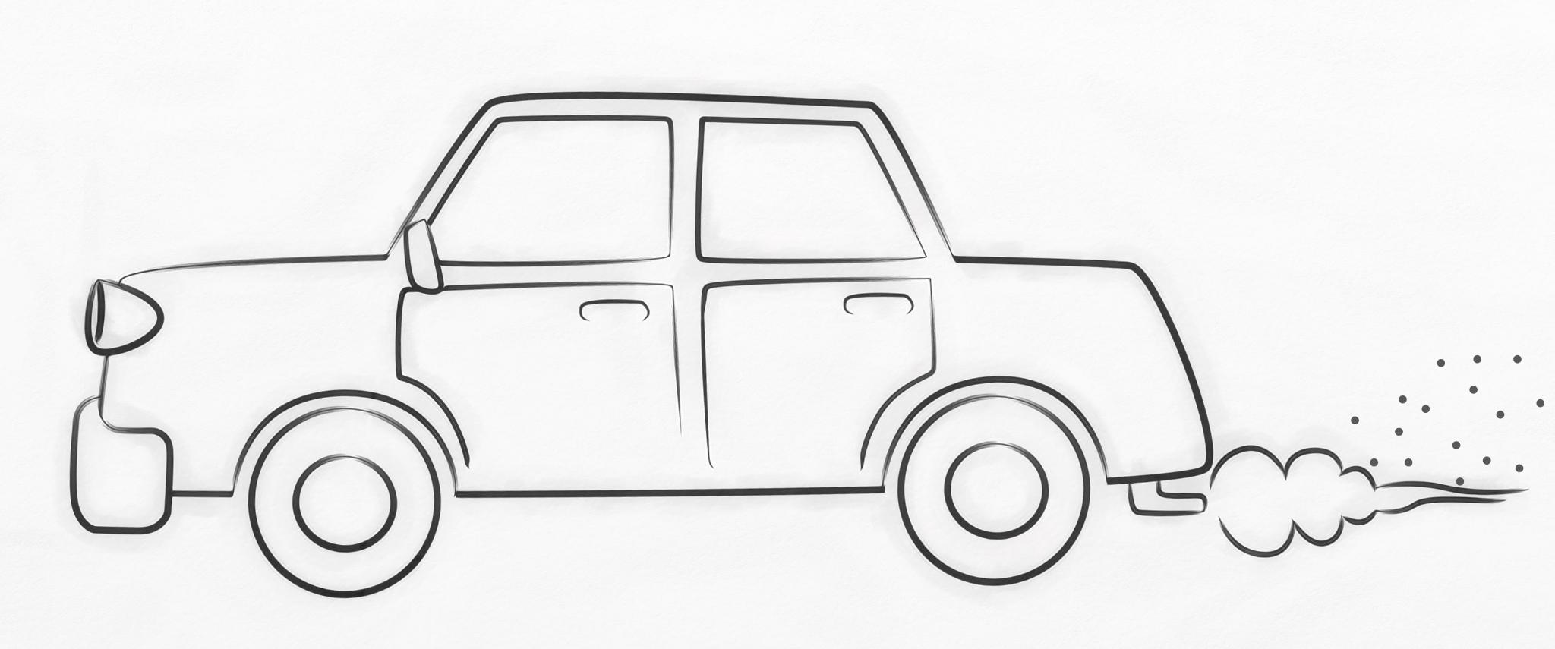
Air pollution
Concentration (in air)
Emission
What is measured
Where you are + what you breath in
Exposure

Slide 19
Nitrogen dioxide (NO₂)
More information on: Together for Clean Air

Slide 20
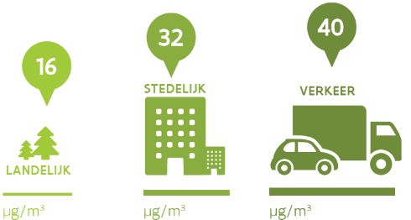
What is NO2?
Nitrogen dioxide =
a harmful gas
released during high temperature combustion
City
Traffic
Countryside
Notes:
Figure gives yearly average on different types of locations in Flanders

Slide 21
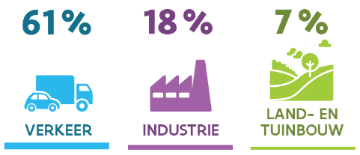
Sources
Traffic is the main source (diesel engines)
The relative importance of traffic continues to increase
Agri- & horticulture
Traffic
Industry
Notes:
Figure gives percentages on different types of locations in Flanders

Slide 22
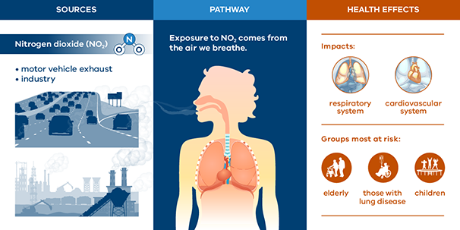
Health effects
Source: EPA Victoria State Government of Victoria

Slide 23
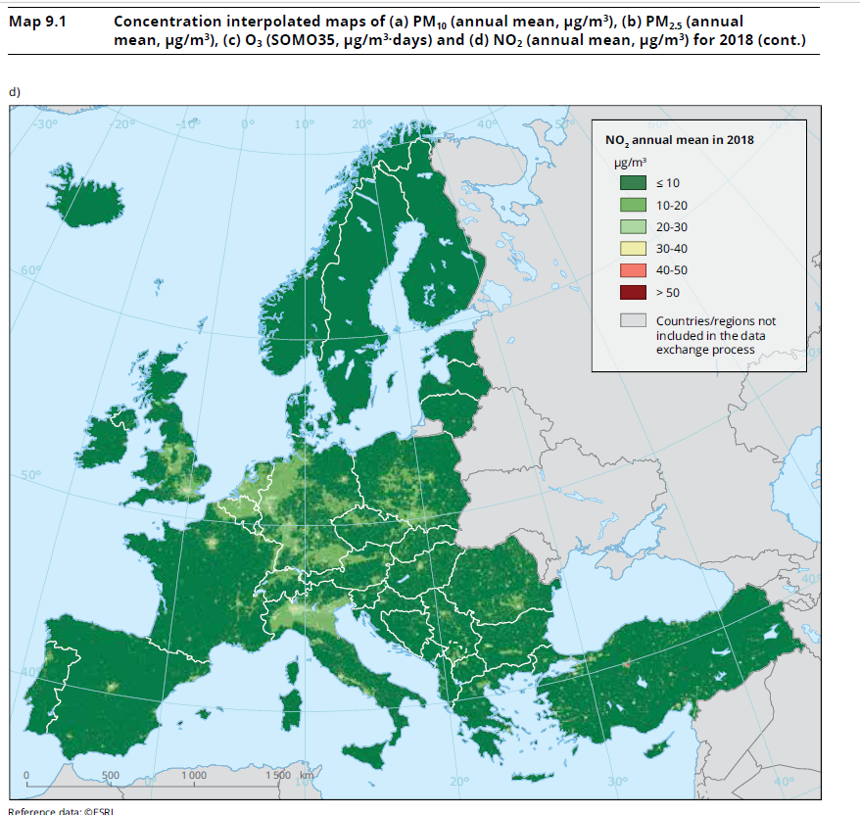
Current situation
NO₂
Source: European Environment Agency, Air quality in Europe - 2020 report

Slide 24
Particulate matter (PM)
More information on: Together for Clean Air

Slide 25
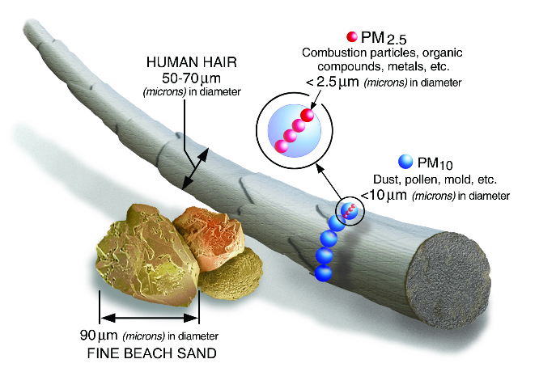
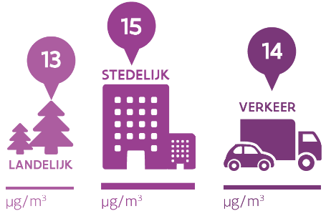
What is PM?
City
Traffic
Countryside
Notes:
Figure gives yearly average on different types of locations in Flanders

Slide 26
What is PM?
Particulate Matter is a MIX:
Primary particles (emitted straight into the air)
Wood smoke, diesel soot, road dust,…
Secondary particles (formed after reactions in the air)
Ammonium salts
Natural particles
Sea salt, Sahara dust,…
Notes:
Primary PM is directly from sources and are in the form of “solid” particles such as sand/dust.
Secondary PM are formed when gases such as sulfur dioxide (SO2, gas), nitrogen oxides (NOx, gas), volatile organic compounds (VOCs, gas) and ammonia (NH3, gas) undergo chemical reactions to form solids such as ammonium sulfate or ammonium nitrate. Ammonia and SO2 (in the presence of water) forms ammonium sulfate; ammonia and NOx (again in the presence of water) forms ammonium nitrate. In addition, secondary particles are developed via the chemical reaction of ozone and organic gases (organic carbon) in the atmosphere.

Slide 27
Sources
Households make the largest contribution through heating
Wood burning is mainly responsible for the emission of particulate matter by households
Households
Traffic
Industry
Notes:
Figure gives percentages on different types of locations in Flanders

Slide 28
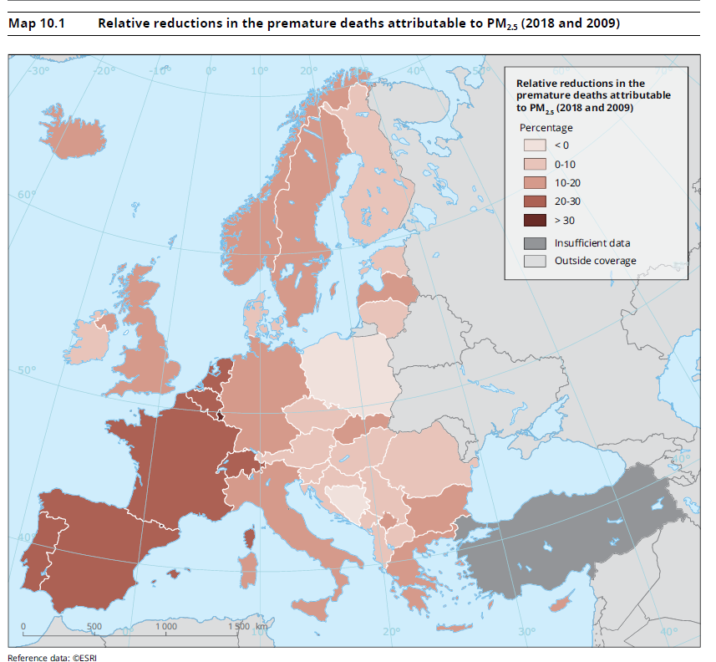
Health effects
Source: European Environment Agency, Air quality in Europe - 2020 report

Slide 29
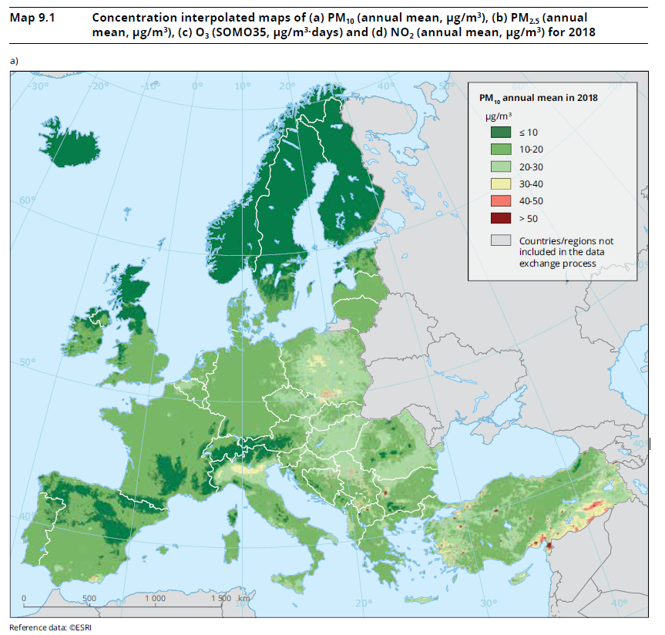
Current situation
PM₁₀
Source: European Environment Agency, Air quality in Europe - 2020 report
Notes:
Interpolation predicts values for cells in a raster from a limited number of sample data points (= AQ measurements in this case). It can be used to predict unknown values for any geographic point data.

Slide 30
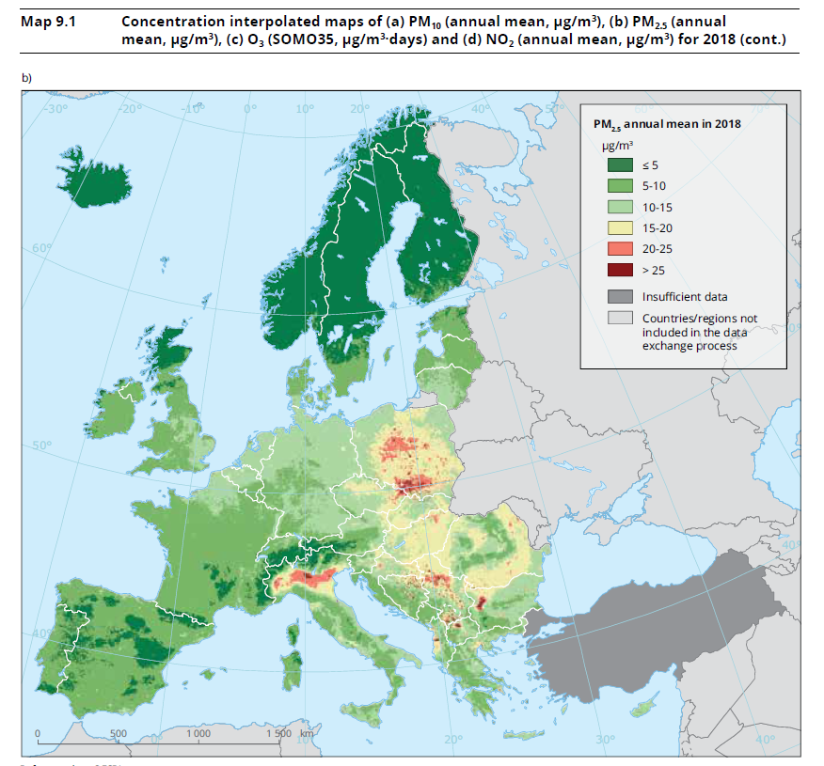
Current situation
PM_{2.5}
Source: European Environment Agency, Air quality in Europe - 2020 report

Slide 31
Black carbon
More information on: Together for Clean Air

Slide 32
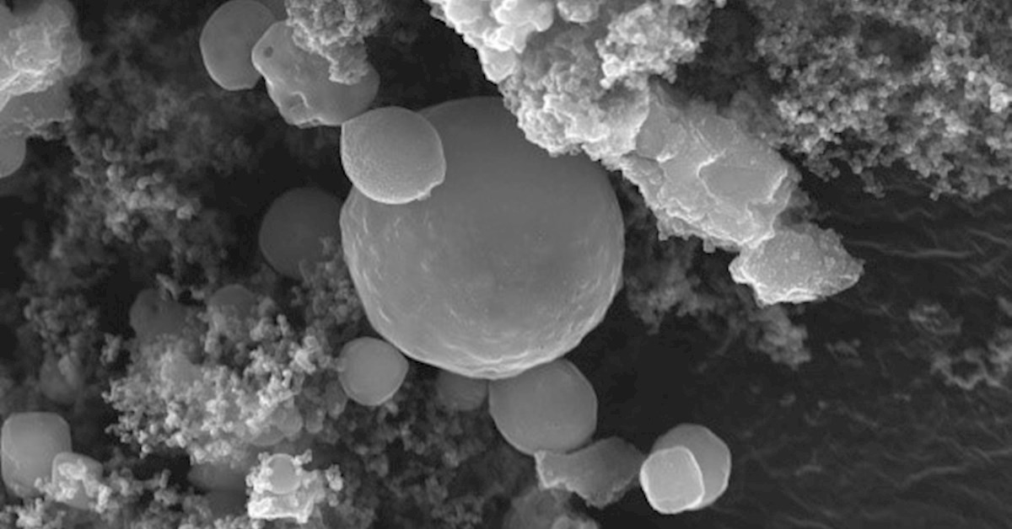
What is Black Carbon?
Black Carbon or BC or Soot
Mixture of very small particles with high light absorption, i.e. “black”
Formed through incomplete combustion
Black carbon levels are a measure of the “carbon” content in particulate matter
Typical size of these particles is 100 - 600nm ⇒ part of PM_{2.5}
Particles coagulate quite rapidly to form larger, less dark/black particles = “regular” PM_{2.5}
Concentration levels vary strongly across a few 100 m <-> PM_{2.5}
BC also contributes to climate change: particles absorb heat because of blackness and locally increase the air temperature
particles are even associated with melting of ice caps after deposition on snow etc.
Notes:
https://forcetechnology.com/en/articles/how-to-measure-and-reduce-emission-of-particles-and-black-carbon-from-ship-engines
https://www.eea.europa.eu/highlights/black-carbon-better-monitoring-needed

Slide 33
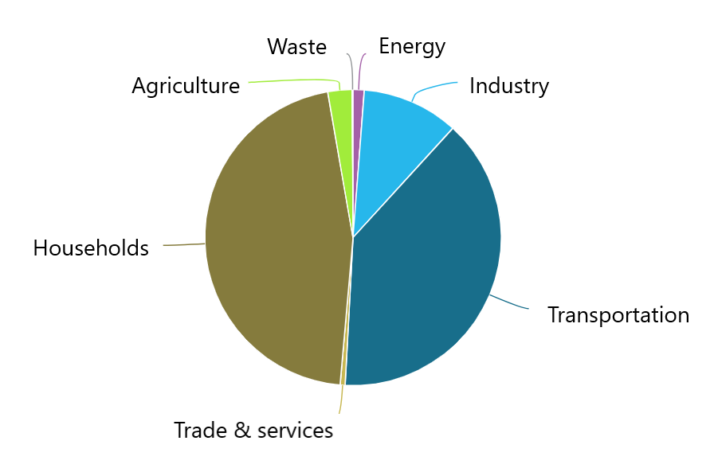
Sources
Mainly consists of particles created by incomplete combustion of fossil and other fuels. E.g. diesel, wood or coal.
Traffic and households are by far the 2 main sources of soot emissions.
Traffic mainly concerns the combustion of diesel and to a lesser extent petrol.
Households mainly emit soot by burning wood in stoves and fireplaces..

Slide 34
Health effects
#1 rule on health effects: the smaller the particles, the further they can move inside our bodies
black carbon particles have been found in the placenta, urine …
BC has a very large surface area, i.e. a lot of interface that can react with components in our body
Additionally it can act as a universal carrier for other chemicals of varying toxicity, e.g. heavy metals, polyaromatics and semi-volatile organics
Black carbon is considered “possibly carcinogenic to humans” by the IARC
Typical health effects:
chronic exposure to higher concentrations has been associated with elevated rates of lung cancer
chronic exposure to higher concentrations has been associated with increased mortality
chronic exposure to higher concentrations has been associated with increased hospital admissions for asthma and cardiovascular diseases
acute (short term) exposure is associated with irritation of the upper respiratory tract
was found in the placenta and in different organs of unborn babies
Notes:
BC factsheet usepa: https://www.epa.gov/sites/default/files/2013-12/documents/black-carbon-fact-sheet_0.pdf
WHO document: https://www.euro.who.int/__data/assets/pdf_file/0004/162535/e96541.pdf
IARC= International Agency for Research on Cancer: https://inchem.org/documents/iarc/vol65/carbon.html
Full WHO Air Quality Guidelines: https://apps.who.int/iris/bitstream/handle/10665/345329/9789240034228-eng.pdf?sequence=1&isAllowed=y
Health effects of air pollution (EEA): https://www.eea.europa.eu/themes/signals/signals-2013/infographics/health-impacts-of-air-pollution/view

Slide 35
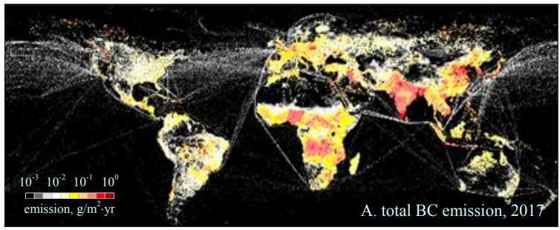
Current situation
Spatial distribution of global BC emission densities from all sources (including wildfires) in 2017 derived in this study*
Notes:
*Updated Global Black Carbon Emissions from 1960 to 2017: Improvements, Trends, and Drivers
Haoran Xu, Yu’ang Ren, Wenxiao Zhang, Wenjun Meng, Xiao Yun, Xinyuan Yu, Jin Li, Yuanzheng Zhang, Guofeng Shen, Jianmin Ma, Bengang Li, Hefa Cheng, Xilong Wang, Yi Wan, and Shu Tao Environmental Science & Technology 2021 55 (12), 7869-7879 DOI: 10.1021/acs.est.1c03117

Slide 36
Impact environmental factors

Slide 37
Weather
The weather is an important factor in the formation and spread of air pollution
humidity influences the formation of PM out of NOx
rain removes PM from the air
wind will dilute and spread pollution
wind direction determines the direction in which pollutants are spread
during heat waves more ozone is formed than during cold days because temperature and sunlight influence the chemical process
atmospheric conditions influence secondary PM formation
atmospheric inversion layers formed during winter captures polluted air in the lowest air layers

Slide 38
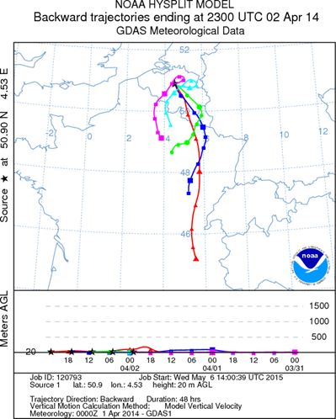
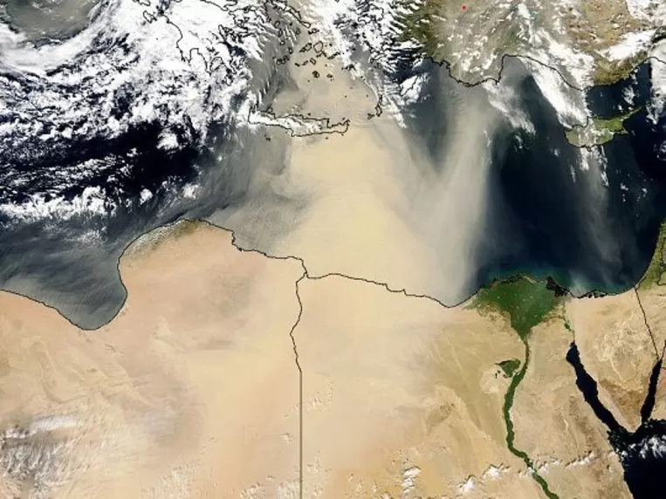
Transportation
Air pollution can travel long distances through the different air layers
E.g. in this way sahara dust can cause a peak in PM in western Europe

Slide 39
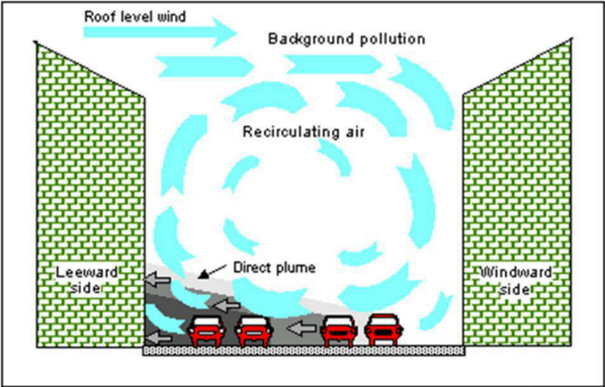
Street canyons
Air moves differently within a narrow canyon formed by buildings in urban areas
Notes:
A street canyon is a place where the street is flanked by tall buildings on both sides creating a canyon-like environment. Such human-built canyons are made when streets separate dense blocks of structures. Street canyons have an effect on wind speed and direction, which also has an effect on local air quality. When the direction of the mean wind is parallel to the street, the channelization increases the dispersion of pollutants inside the street canyon. This often act to 'flush out' the air pollutants and increase the air quality inside the street canyon. But in instances where air pollutant sources are present upwind, channeling winds could transport pollutants to downwind locations far from the source and contribute to bad quality at the downwind locations. When the mean wind direction is perpendicular to the street, the vortex flow formed inside the canyon acts to confine air flow, reduce dispersion of pollutants and increase the pollution concentrations inside the street canyon. Pollution from local source inside the canyon and also pollution entrained into the canyon from the mean wind flow, is carried by the vortex flow and is re-circulated within the canyon.

Slide 40
Interesting websites

Slide 41
Interesting websites
https://samenvoorzuiverelucht.eu/en/together-clean-air
https://www.eea.europa.eu//publications/status-of-air-quality-in-Europe-2022
https://www.eea.europa.eu/data-and-maps/dashboards/air-quality-statistics
https://www.eea.europa.eu/publications/air-quality-in-europe-2021/health-impacts-of-air-pollution

Slide 42
COMPAIR D5.1
Guide to Air Quality Monitoring
Chapter 2: Low-Cost Sensor (LCS) Training

Slide 43
Chapter 2: Low-Cost Sensor (LCS) Training
Types of PM Measurement Equipment
Types of NO₂ Measurement Equipment
Types of Black Carbon (BC) Measurement Equipment
Measurement Approaches of Low-Cost Sensors (LCS)
LCS Applications
LCS response time and overall performance

Slide 44
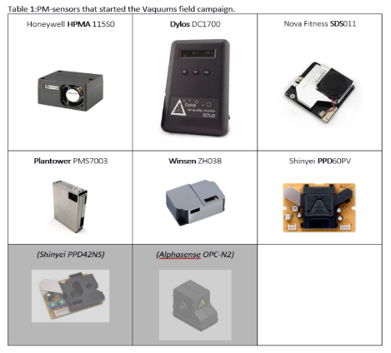
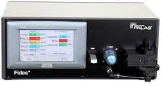
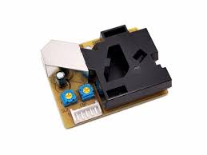
Types of PM Measurement Equipment
LCS (optical sensors)
Reference Station
EU gravimetric reference
(PM_{2.5} only)
EU equivalent method
(Palas Fidas 200)
Shinyei PPD42NS
Cubic sensors ltd PM2012
Sensirion SPS30
Notes:
PM can be measured using low cost optical sensors as well as research-grade analyzers found at reference stations or at certain industries across the EU.
To the left are some examples of low cost PM sensors, of which the type used in CompAir is the “Sensirion SPS30”. To the right are some examples of analyzers found at reference stations.
Reference articles on PM sensors:
From low-cost sensors to high-quality data: A summary of challenges and best practices for effectively calibrating low-cost particulate matter mass sensors – ScienceDirect
A Review of Low-Cost Particulate Matter Sensors from the Developers’ Perspectives - PMC (nih.gov)

Slide 45
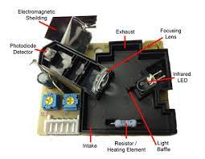
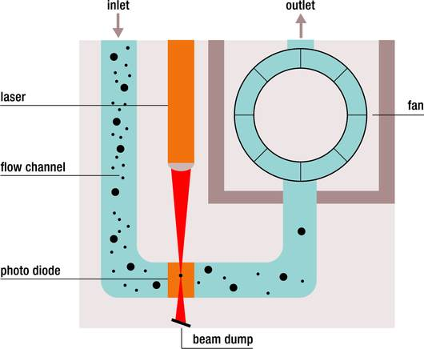
Measurement Approach of PM LCS
Shinyei PPD42NS
PM optical sensor
Notes:
To the left is a pictorial representation of the working principle of a low cost optical PM sensor. This sensor works on the principle of laser scattering. The sensor has a fan which creates a controlled airflow so the environmental particulates (with a diameter if <10µm and <2.5µm) pass through a focused laser beam. The particulates cause light scattering which is detected by a photodiode and then converted into PM concentration with the help of its microprocessor.
To the right are images of example sensor boxes interior components, that are labeled for visual purposes.

Slide 46
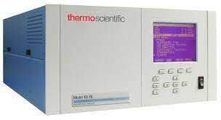
Types of NO₂ Measurement Equipment
Passive samplers (Palmes tubes; 2week/1month average data)
Electrochemical sensors: real-time data
Alphasense NO₂-B43F
Reference Station
Chemiluminescence Analyser
(42i ThermoFisher Scientific)
Notes:
NO2 can be measured using low cost passive samplers such as Palmes tubes (from which data can be obtained on a biweekly or monthly average basis) or low cost electrochemical sensors (from which data can be obtained in real-time) as well as research-grade analyzers found at reference stations or at certain industries across the EU.
To the left are some examples of low cost NO2 measurement options using samplers and sensors, of which the type used in CompAir is the “Alphasense NO₂-B43F”. To the right is an example of an analyzer found at reference stations.

Slide 47
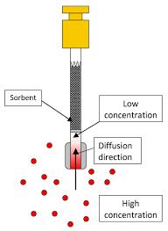
Measurement Approach of NO₂ passive samplers
NO₂ passive sampler (Palmes tubes)
Diffusive samplers in the European Union for the monitoring of nitrogen dioxide in ambient air
In the Palmes tubes samplers, after collection, the NO₂ concentration is analyzed via a colorimeter / spectrophotometer
Notes:
To the left is a pictorial representation of the working principle of a passive sampler used as a standard low cost measurement technique for NO2.
In a Palmes-type passive diffusion tube, molecules of NO₂ diffuse along a fixed-length path driven by the concentration gradient established in the tube by their reactive conversion into nitrite (NO₂⁻) with the triethanolamine (TEA) absorbent at the inner end. After exposure, the NO₂⁻ is extracted quantified by ion chromatography or colorimetric procedure or spectrophotometry.
To the right are images of other example diffusive samplers.

Slide 48
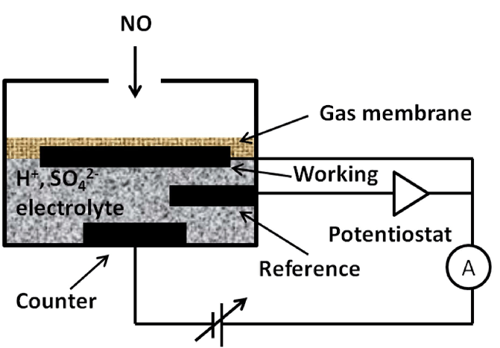
Measurement Approach of NO₂ LCS
NO₂ electrochemical sensor
Notes:
To the left is a pictorial representation of the working principle of a low cost electrochemical NO2 sensor.
The gas that comes into contact with the sensor passes through a hydrophobic membrane and diffusion limiting orifice and eventually reaches the surface of the “sensing” (or working) electrode. At the surface of the “sensing” electrode an oxidation or reduction reaction occurs, which results in a current between the “sensing” electrode and “counter” electrode. The magnitude of this current is proportional to the gas concentration. The reference electrode is used to anchor the working electrode at a stable potential, which is achieved by connecting it to the working electrode via a potentiostat.
To the right is a labelled image of the components of the NO2 sensor used in CompAir.

Slide 49
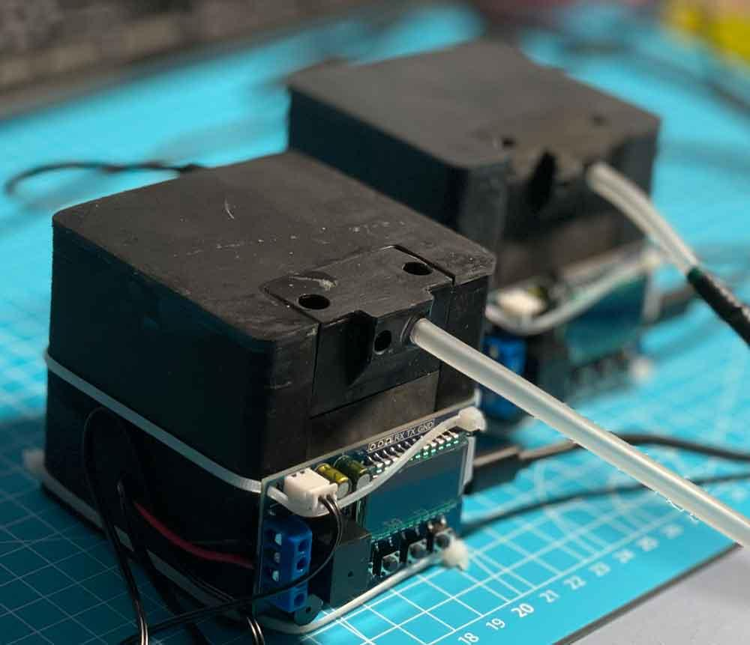
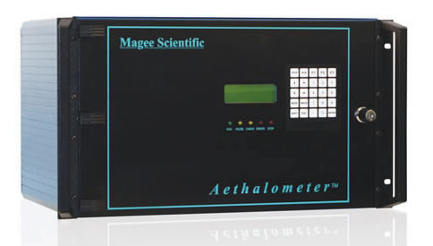
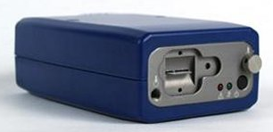
Types of Black Carbon (BC) Measurement Equipment
Light attenuation LC BC sensors
Static:
BCmeter
Portable:
Aethlabs
(microAeth® Model AE51)
Aethalometer (Magee Scientific)
Notes:
Black Carbon (BC) or soot can be measured using low-cost light attenuation sensors as well as reference-grade analyzers found at reference stations.
To the left are some examples of low cost BC sensors, of which the type that is being considered to be used in CompAir is the “BCmeter”. To the right is an example of an analyzer found at reference stations.

Slide 50
Measurement Approaches of BC LCS
Detailed working principle
Simplified
working
principle:
BCmeter
Internal assembly
Notes:
To the left is a simplified pictorial representation of the working principle of the “BCmeter" low cost BC sensor proposed to be used in CompAir. Its working principle is as follows:
Polluted air passing through filter paper
Filter paper absorbs black carbon (BC)
Sensor measures attenuation of LED shining at 880nm through filter paper (and bias of environmental light changes)
Data is evaluated by Python script and saved as .csv
Data is displayed in web browser
To the center is a more detailed pictorial representation of the working principle of a low cost BC sensor. As polluted air is drawn, light absorbing BC accumulates on the first ‘signal’ filter and the transmitted light intensity dims predictably over time. Filtered air (devoid of PM) then passes through the second ‘reference’ filter, so it is unaffected by BC concentrations. By comparing the reference light intensity to the signal, it is possible to isolate the light attenuation resulting from BC absorption alone, while eliminating other factors. Using the light attenuation data, BC concentrations can be calculated in real time. The filter tab is replaced when too much BC has collected on the filter, and the light intensity signal degrades.
To the right is a labelled image of the interior components of a BC sensor.

Slide 51
LCS Applications
Enables spatially dense, high temporal resolution measurements of air quality to be made economically
Beneficial in areas where the concentration of air pollutants have significant spatial gradients
Inexpensive and can be portable, compared to reference monitoring station
Specific use cases for sensors include outdoor monitoring in a stationary or mobile mode, indoor environment monitoring and personal monitoring

Slide 52
LCS response time and overall performance
Response time
Time at which the output reaches a certain percentage (e.g. 95%) of its final value, in response to a step change of the input.
Overall performance
Sensitivity to cross-interferences from other atmospheric pollutants, and environmental variables, such as temperature and humidity
Limitation of sensor longevity and long-term stability
Variance compared to reference monitoring stations
There is a limit to the performance one can expect from a (calibrated) LCS ~100€ and a reference-grade sensor ~ 100k €.
Reference device
Uncalibrated
reference device
Calibrated LCS
(hopefully)
The usual case
for LCS
Notes:
This slide addresses some of the many factors affecting the overall performance of sensors such as environmental variables, sensor lifespan. It then compares “low-cost” sensors performance through “accuracy” and “precision” in measurements with that of “expensive” analyzers found at reference monitoring stations.
Accuracy of the sensor is the closeness of a measured value to a known value. Precision can be described as the reproducibility of measurements. When your sensors are precise,they will give more or less the same result.
In the figure, the “known value” is represented by the innermost ring of the orange rings. The figure shows four cases, each looking at six sensor responses (shown by blue crosses).
Case 1: “high accuracy and high precision” this indicates that all sensors’ measured values are closest to the known value aka highly accurate and among the sensors, they are consistent meaning giving more or less the same result aka “highly precise”
Case 2: “low accuracy and high precision” this indicates that all sensors’ measured values are furthest to the known value aka have low accuracy but among the sensors, they are consistent meaning giving more or less the same result aka “highly precise”
Case 3: “high accuracy and low precision” this indicates that all sensors’ measured values are close to the known value aka have high accuracy but among the sensors, they are inconsistent meaning they are not giving the same result aka have low precision
Case 4: “low accuracy and low precision” this indicates that all sensors’ measured values are neither close to the known value (low accuracy) nor are the sensors consistent among each other (low precision)

Slide 53
COMPAIR D5.1
Guide to Air Quality Monitoring
Chapter 3: Sensor Maintenance Training

Slide 54
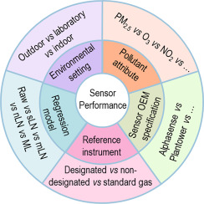
Chapter 3: Sensor Maintenance Training
Sensor Calibration
Sensor Cleaning
Sensor Inspection
Sensor Replacement

Slide 55
Why do sensors need to be calibrated?
No sensor is “perfect”
Two sensors from the same manufacturer production run may yield slightly different readings
Two sensors in similar conditions having differences in design may respond differently
Environmental variabilities such as temperature, shock, humidity, etc. during storage, shipments and/or assembly may result in a change in sensor response
Sensors may ‘age’ meaning their response may change over time requiring re-calibration
Notes:
Refer to slides titled “How to calibrate sensor data” for more details.

Slide 56
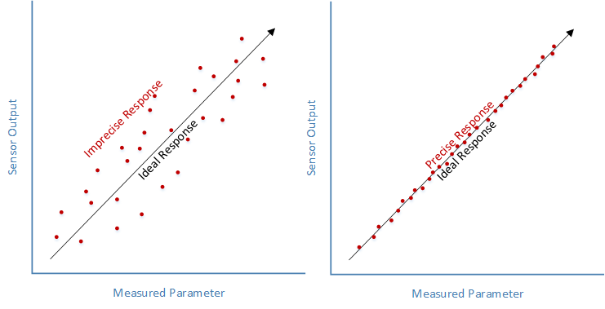
What is sensor calibration?
Sensor (or device) calibration means adjustments made to the sensor to make it function with minimum deviation from official standards
Sensor calibration is to ensure accuracy in sensor measurements to have:
“precision” meaning ability to always produce the same output for the same input
and
“resolution” meaning ability to reliably detect small changes in the measured parameter
Notes:
Accuracy of the sensor is the closeness of a measured value to a known value.
Basic steps to calibrate a sensor/sensor data:
Take a measurement with the sensor.
Compare that measurement with the reference standard.
Subtract the sensor reading from the reference reading to get the offset.
In the code, add the offset to every sensor reading to obtain the calibrated value.

Slide 57
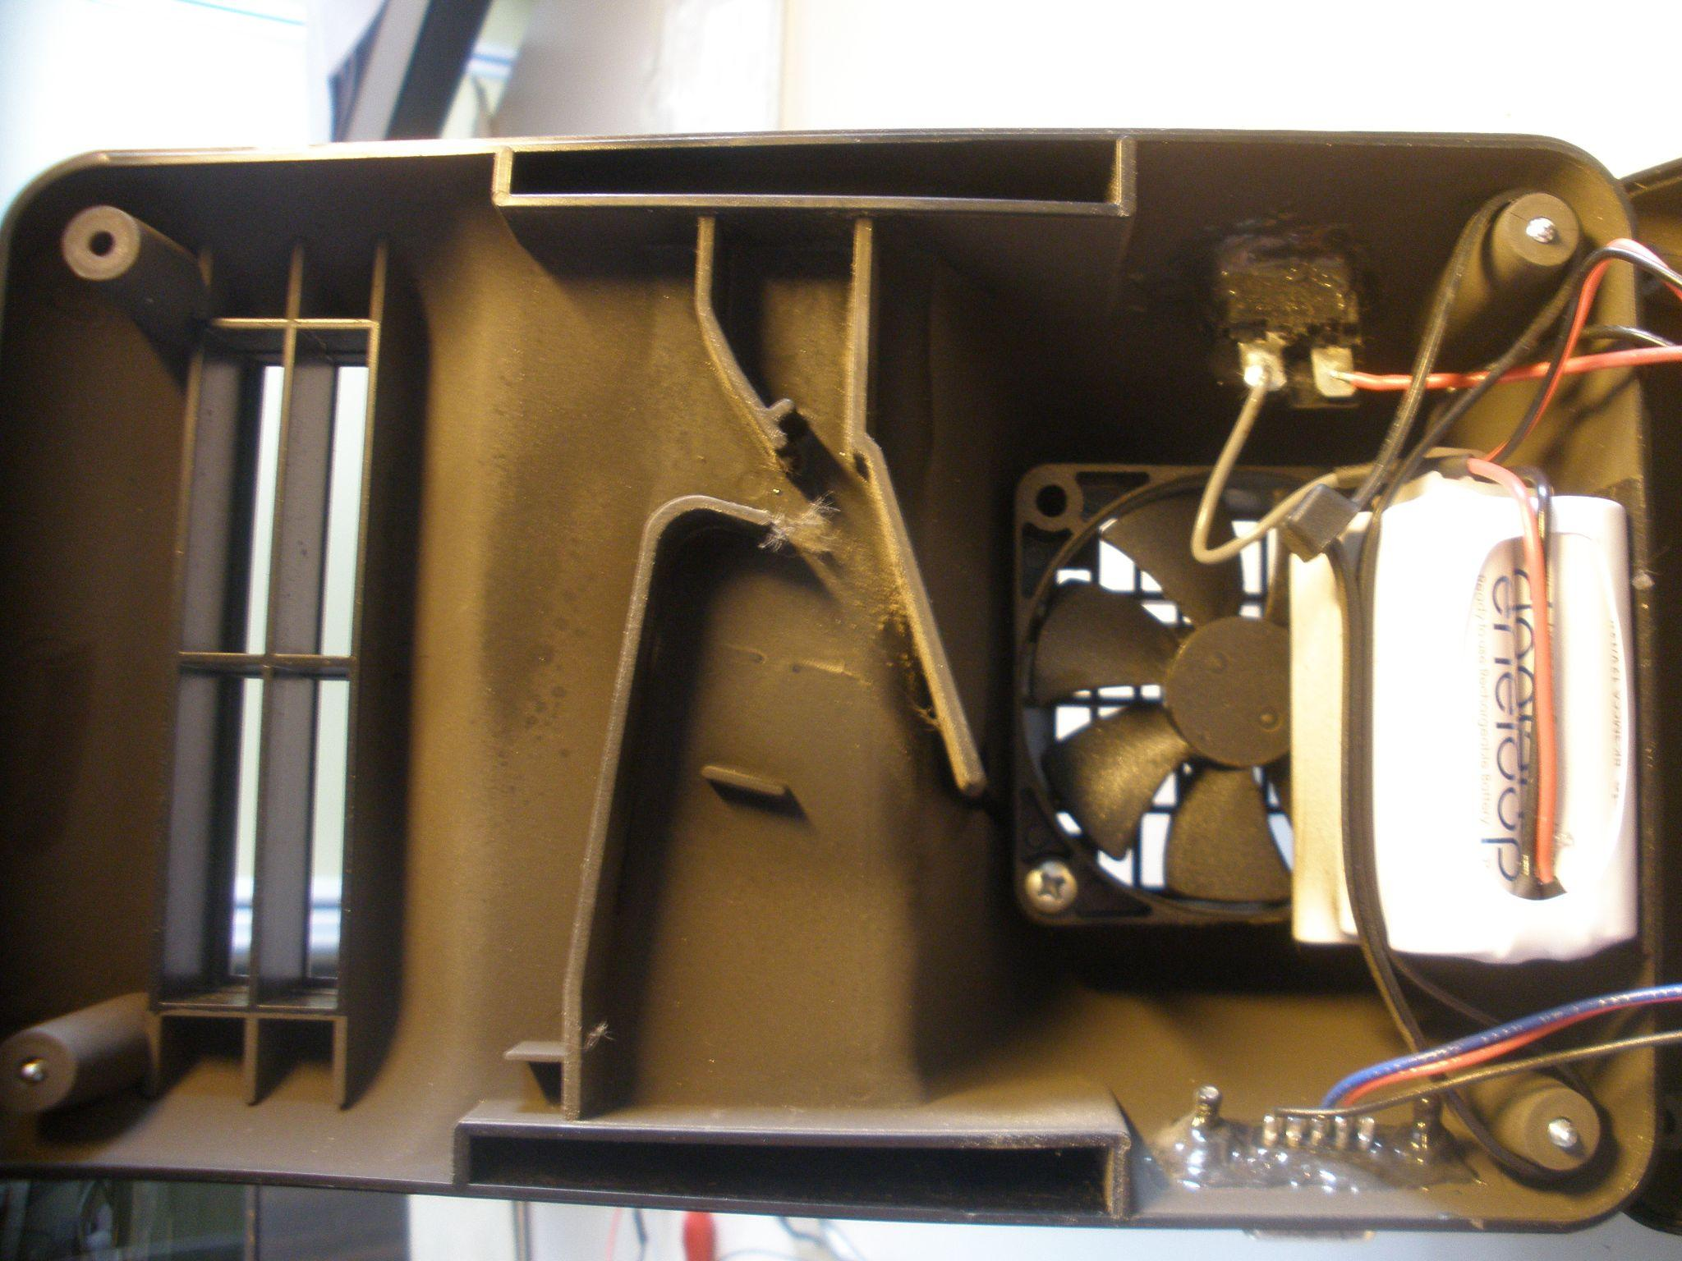
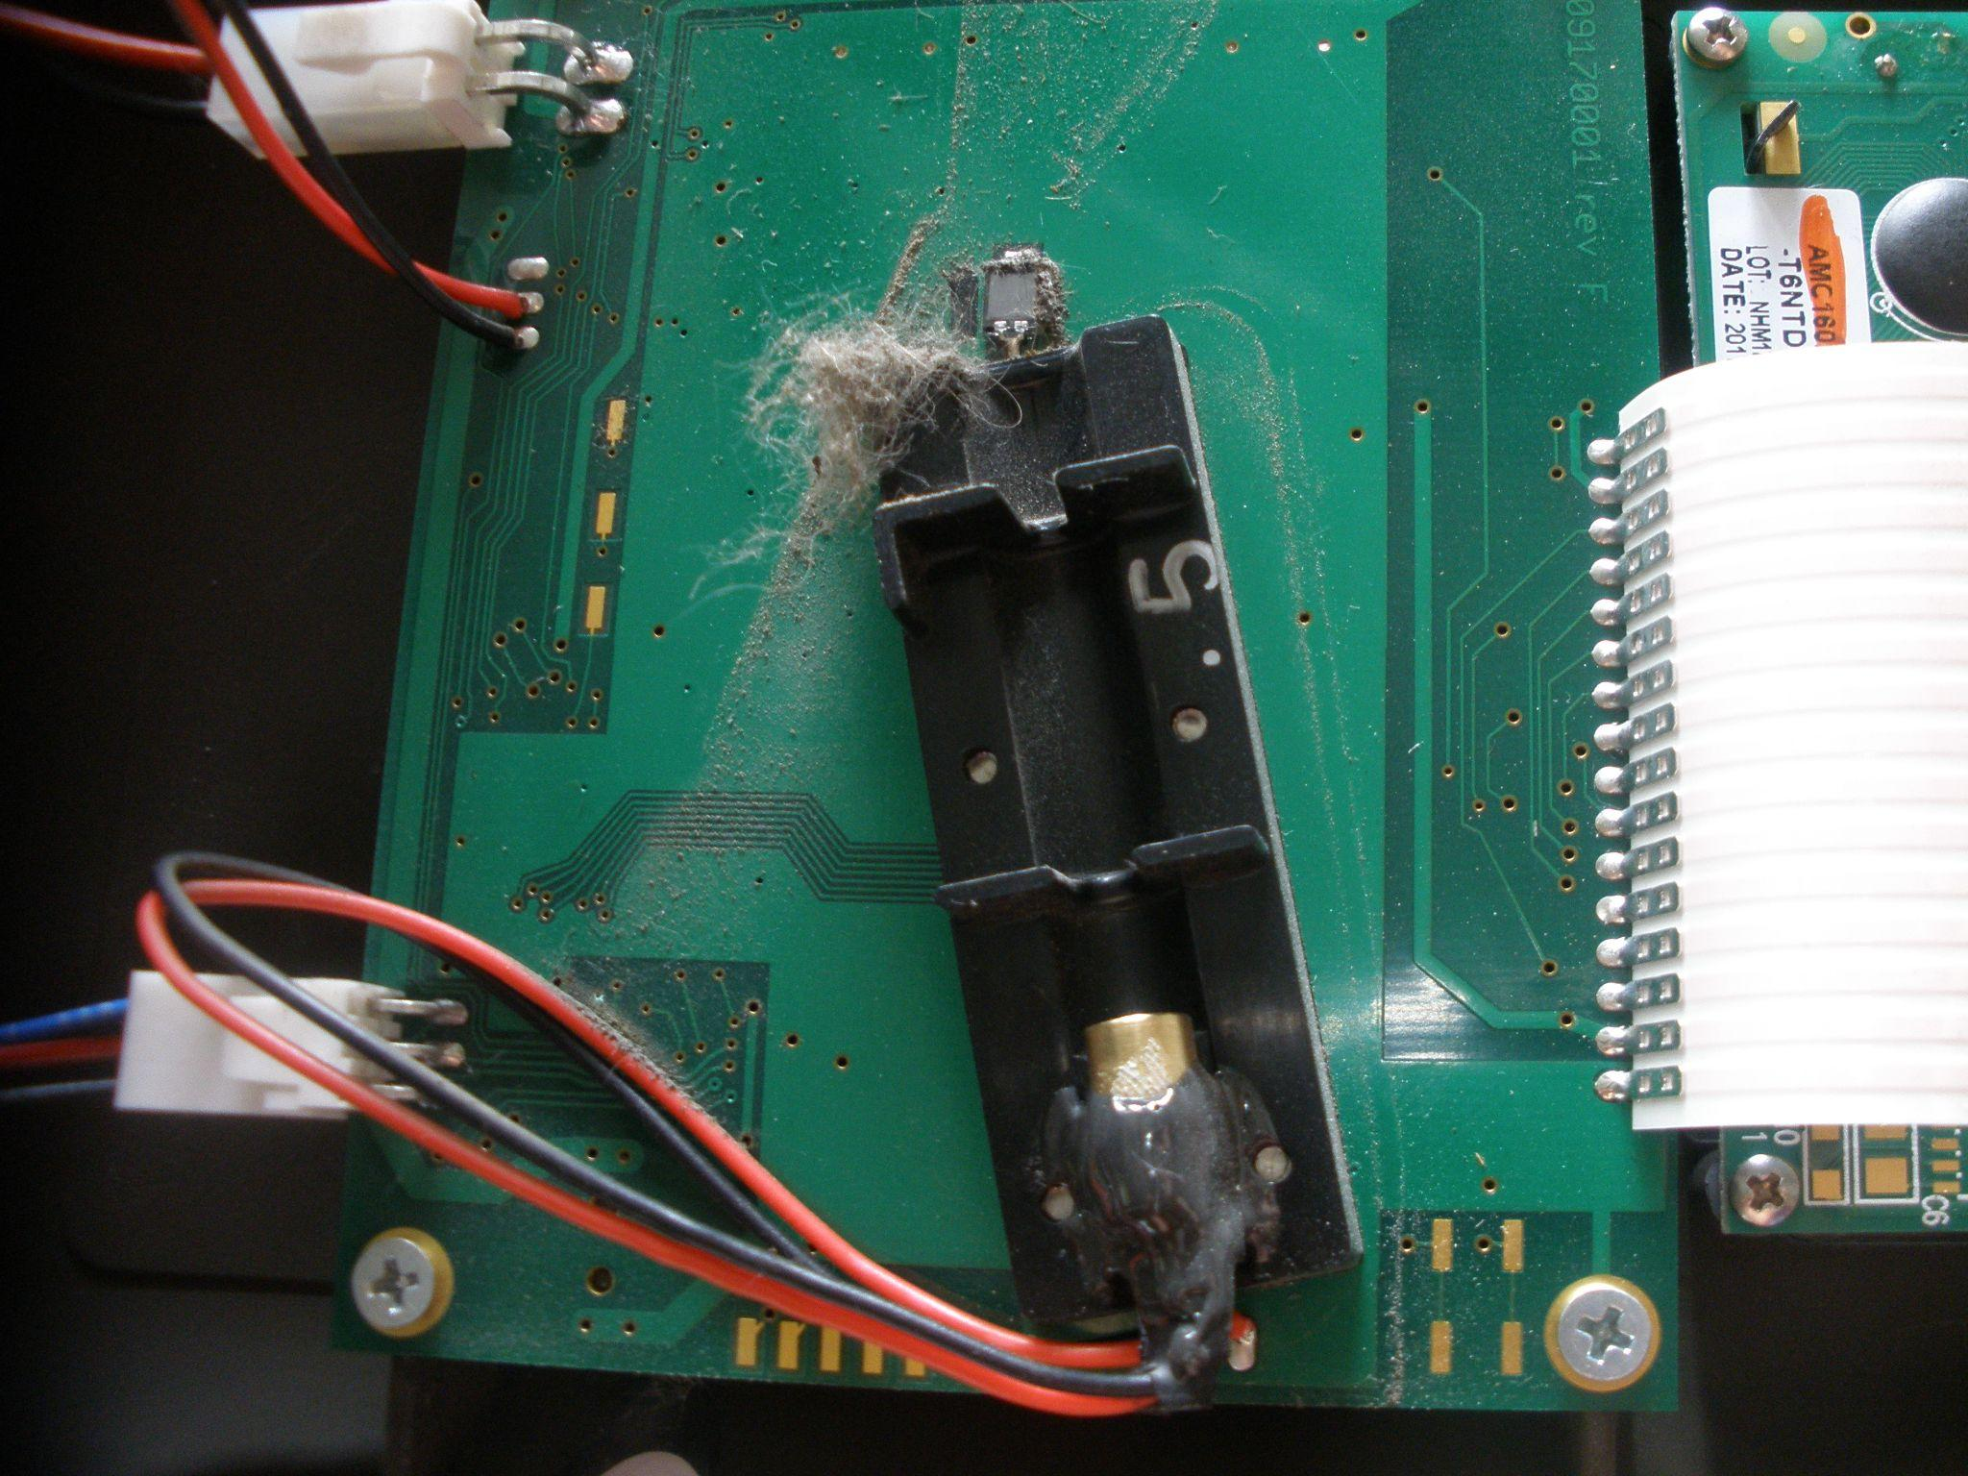
Sensor Cleaning
Dust accumulation on sensors, results in incorrect readings and affects product performance

Slide 58
Sensor Inspection
There are two ways to perform sensor inspection:
Regular (e.g. daily) inspections to check if the sensor is measuring and if data is being processed continuously
Periodic (e.g. monthly) inspections to check the physical condition of the sensor such as keeping dust and moisture away and ensuring no excessive rusting and corrosion

Slide 59
Sensor Replacement
Sensor maintenance, inspection and cleaning can only go so far. If realignment or repairing occurs more often, it maybe time to replace the sensor or other components depending on warranty.
Sensor manufacturers provide the expected lifespan (usually a year) of the sensor. Sensor replacement is also advised upon expiration.

Slide 60
COMPAIR D5.1
Guide to Air Quality Monitoring
Chapter 4: Sensor Data Collection Training

Slide 61
Chapter 4: Sensor Data Collection Training
Data Collection and Calibration
Assess data quality, patterns, anomalies
Assess interfering chemical compounds, drift

Slide 62
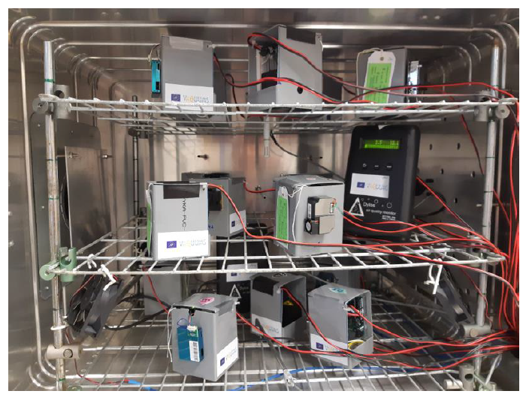
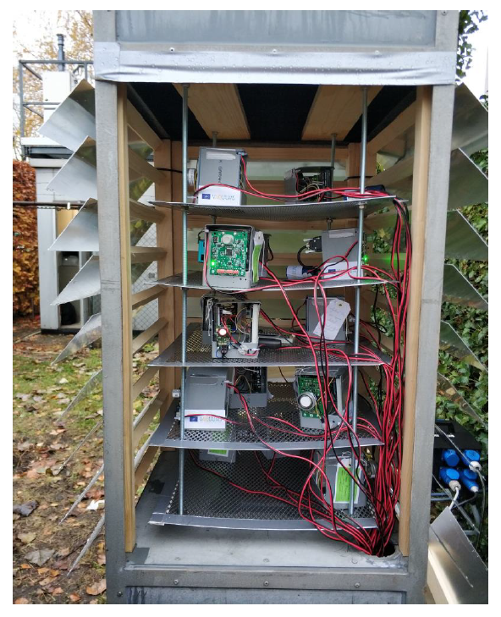
How to calibrate sensor data?
Step 1: Select a “Standard Calibration Reference” to calibrate against. This can be a:
known concentration of measured parameter in a laboratory
reference monitoring station
calibrated sensor
Laboratory Tests 🡪
Step 2: Deploy the sensor to compare to the reference:
Laboratory Tests - exposing sensor units to “known concentration of measured parameter in a controlled laboratory” setting
Field Tests - deployment of sensor units next to high-grade “reference monitoring stations” under realistic conditions
Field Tests 🡪
Notes:
The method used to calibrate sensors is the same as calibrating sensor data. Once a sensor is developed, it should undergo preliminary calibration what we refer to as “sensor calibration”. This is usually done in the laboratory against a known concentration or by comparing a batch of sensors with each other. If this has been calibrated properly in the laboratory, there is no need for further calibration. If the sensor cannot (or very difficult to) be calibrated properly under laboratory conditions, field calibration is performed what we refer to as “sensor data calibration” by comparing sensor data to reference station data.

Slide 63
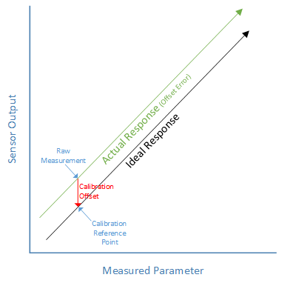
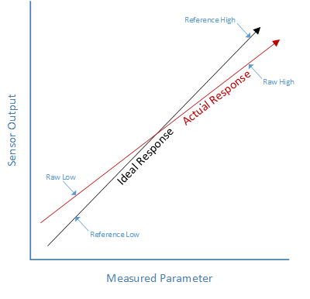
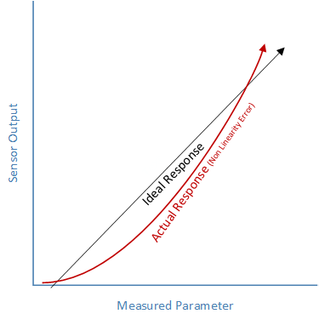
How to calibrate sensor data?
Step 3: Determine the sensor’s “Characteristic Curve”, which defines the sensor’s response to an input.
The calibration process maps the sensor’s response to the reference’s (or ideal) response.
Step 4: Apply the suitable calibration method:
One Point Calibration (used to correct for sensor offset (an offset means that the sensor output is higher or lower than the reference (or ideal) output)
Two Point Calibration (used to correct differences in slope or sensitivity (differences in slope or sensitivity means that the sensor output changes at a different rate than the reference (or ideal) output)
Multi-Point Curve Fitting Calibration (usually the case with LCS)

Slide 64
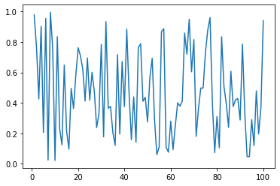
Novel calibration method:
imec Distant Sensor Calibration
imec will calibrate CompAir data using nighttime data analysis – Basics:
LCS
Notes:
Nighttime data analysis is a technique in which the nighttime (more uniformly distributed) data is used to calibrate the data acquired during the daytime, which is less uniformly distributed due to pollutants generated from human activities (car emissions, particles).

Slide 65
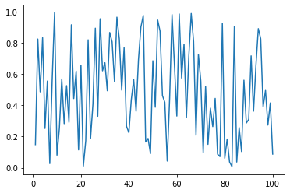
imec Distant Sensor Calibration - Basics
moving window of y days
Ref3
Ref2
LCS
x km
API
LCS
Ref2
Ref1
(1) Clean data (remove unrealistic values)
(2) Train (MLR) model (example: a * RAW+ b = CAL but more complex)
(3) Apply a, b to calibrate RAW values in real-time
Ref4
Notes:
In distant calibration, first the out-of-range low cost sensor data that is due to measurement error is cleaned using value thresholds.
Then, the best reference sensor that is located at a distance (“x” km from the LCS) is selected by analysing the correlation between low cost sensor data and reference sensor data during nighttime (as discussed in the previous slide).
This reference sensor data is used to train a multi linear regression model (for a period of “y” days), which reduces the influence of environmental parameters such as temperature and humidity on the measurement. The parameters extracted from this training, is used to calibrate the day-time values of the low-cost sensor in real-time.

Slide 66
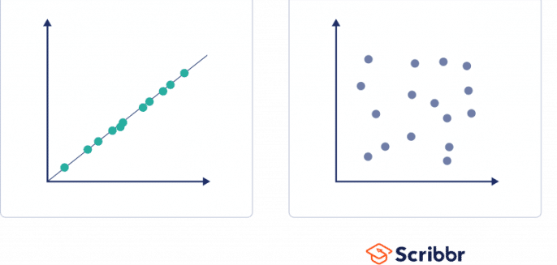
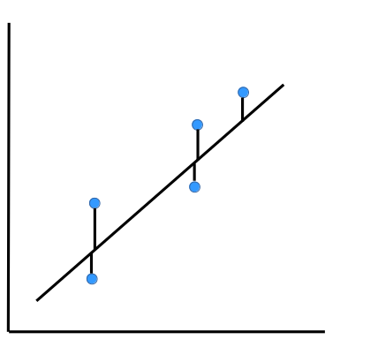
Metrics used to quantify data quality: what do they mean?
Correlation: If “real value” increases, does measured value increase proportionally?
Metrics: Correlation coefficient (r) , coefficient of determination (R²)
Accuracy: How far is the measured value from “real value”?
Metrics: Mean absolute error (MAE), root-mean squared error (RMSE), mean bias, etc.
Between-sensor uncertainty: How comparable is one LCS unit from another?
Expanded uncertainty: If we only look at the sensor data around the limit value, what is the range within which we are reasonably confident the true value can be found?
r<0.01
reference
r=1
LCS
reference
LCS

Slide 67
Interfering chemical compounds, drift
Drift is a measurement error caused by the gradual shift in a sensor’s measured values over time. Drift can be caused due to:
Time / Sudden Shock / Environmental Changes / Vibrations / Normal Wear and Tear / Improper use / Debris Buildup / Interfering Chemical Compounds
Notes:
The image is an example of drift seen in sensor readings when compared to the standard (or reference) readings.
In this NO2 LCS example,
A “good” sensor is one in which only the NO2 is being exposed to the sensor and all of the O3 (ozone) is left out. In such a sensor, raw sensor signals correlate with reference NO₂ concentrations
An “aging” sensor is one in which the NO2 is being exposed by the sensor and a portion of the O3 (ozone) is also being exposed. In such a sensor, raw sensor signals start to deviate from reference NO₂ concentrations due to the scrubber aging from being able to fully scrub out the O3.
A “malfunctioning” sensor is one in which sensor raw signals show no correlation with reference NO₂ concentrations rendering the sensor “non-functional” and due for replacement

Slide 68
COMPAIR D5.1
Guide to Air Quality Monitoring
Chapter 5: Making sense of sensor data and its implications for research, policy and practice

Slide 69
Contents
Practice
Examples of experiments
Research:
Steps to take when starting an experiment
Policy:4 cases
Schoolstreet
Low Emission zone
Traffic Circulation plan
Influence Covid lockdown on air quality

Slide 70
Practice
Education - Growing in experience - Measuring - Searching for solutions

Slide 71
Indoor air quality - experiment 1
How does my (neighbours) heater affect the air quality in my house?
What do you measure?
Particulate matter (PM): harmful to health
PM is a good indication for wood combustion
Next to PM10, the finer fraction (PM2.5) is the most dangerous and thus representative of your health
When do you measure?
Very diverse throughout the seasons - impact mainly measured in wintertime !

Slide 72
Indoor air quality - experiment 1
How does my (neighbours) heater affect the air quality in my house?
Where do you measure?
Put the device on the back of your house where you
mostly sit / you can combine with one indoor.
Ensure a good air flow around the device.
How do you measure?
You need an active measuring device, which measures at different times a day. because you need more than one event per day.
With a PM sensor you collect data per minute or second.

Slide 73
Outdoor air quality - experiment 2
What is the impact of traffic on the air I breathe, when cycling?
What do you measure?
Nitrogen Dioxide (NO2), is the best measure for traffic
When do you measure?
You need to measure different moments a day- you need an active measurement method like a sensor with a fast response time.

Slide 74
Outdoor air quality - experiment 2
What is the impact of traffic on the air I breathe, when cycling?
Where do you measure?
Put the measuring device on a representative place for inhaled air
for instance, on your backpack or your bicycle basket
How do you measure?
Keep a logbook: weather / other important information:
Measure while you walk or cycle and keep track of the times in the logbook
Compare with a reference measurement (e.g. via the data portal on the together for clean air website for Flanders)
Notes:
Data portal (Flanders/Netherlands): https://samenvoorzuiverelucht.eu/dataportaal

Slide 75
Outdoor air quality - experiment 3
What is the effect of temporarily making the street at the school gate traffic-free?
What do you measure?
Nitrogen Dioxide (NO2), is the best measure for traffic
When do you measure?
Measuring before and during the introduction of the car-free school moments

Slide 76
Outdoor air quality - experiment 3
What is the effect of temporarily making the street at the school gate traffic-free?
Where do you measure?
Put the measuring device on a representative place for inhaled air:
on an average height of a student (E.g. 1m for children, 1.5m for adults)
at the school gate, on the street site, on the playground, …
In the classroom (relevant for exposure, but not for measuring the impact of the schoolstreet)
How do you measure?
A sensor or a sampler - a sensor can give you a result every minute or second
Keep a logbook: weather / other important information
Measure while you walk or cycle and keep track of the times in the logbook
Compare with a reference measurement
Notes:
For example, if there is a lot of dust that day due to road works, it can be useful to note this in your logbook. This can help to interpret your data afterwards.

Slide 77
I build a sensor - but does it work properly?
You want to know ….
Is your sensor stable?
in different circumstances?
on a long term?
when there’s a high humidity?
…
Frequency of testing your sensor?
Measure for at least 3 months,
repeat the same test after 1 year: ‘aging of the sensor’
Note that the meteo will impact your measurements too

Slide 78
I build a sensor - but does it work properly?
What do you measure?
Particulate matter (PM) - for at least 3 months
use your self-made sensor
Where do you measure?
To be representative you measure at a height of 2.5- 4 m, this is the standard
Then compare with a measurement on the same time measured with a reference monitor, e.g. for Flanders you can look at the VMM-website or at the data portal of the Togetherforcleanair-website.
You can also look at models for more indication

Slide 79
I build a sensor - but does it work properly?
Precision
To know the precision of you sensor, you need to measure if possible with 3 sensors at the same time and place.
Are the results similar? or are there differences between the different sensors?
Then compare with a measurement on the same time measured with a reference monitor, e.g. for Flanders you can look at the VMM-website or at the data portal of the Togetherforcleanair-website.
You can also look at models for more indication
Notes:
Data portal (Flanders/Netherlands): https://samenvoorzuiverelucht.eu/dataportaal

Slide 80
I build a sensor - but does it work properly?
Keep a logbook
note the events in the environment, that are of interest
note the state of the weather during the measurements
are there outliers, and can you explain them?
you need this for the interpretation of your data
Using sensors, means also testing the sensors:
tests in a lab (by laboratory / Institution/ …)
test and calibrate in the field
calibration while measuring
-> See Chapter 4: Data Collection Training

Slide 81
Air quality sensor - the quality of the sensor
Testing and calibration of sensors
Create a web environment where everybody can be part of

Slide 82
Air quality experiments in schools
Toddlers are counting cars and bikes in the street
Primary school children are building measuring systems to measure air quality

Slide 83
Air quality experiments in schools
Instead of taking the bus (like they did before), schoolchildren now are moving safely with steps to go swimming ! This is healthier and better for the environment!

Slide 84
Air quality experiments in schools
Searching for safer and healthier bike routes
Notes:
https://irceline.umotional.com/

Slide 85
Air quality experiments in schools
Outdoor teaching

Slide 86
Car-free street when school starts/ends

Slide 87
Citizen Science
How to measure particulate matter / CO2 / NO2
Examples of projects done by citizens:
Citizens measured the air quality in the neighbourhood of a harbor
Citizens measured the air quality in buildings in function of the height
INDOOR VERSUS OUTDOOR MEASUREMENTS

Slide 88
Mobile measurements
•Urban air quality => large temporal and spatial variability
•Spatio-temporal data => limited temporal resolution
•Repetitions are needed
Notes:
Information shared by the RI-URBANS project.
Research Infrastructures Services Reinforcing Air Quality Monitoring Capacities in European Urban & Industrial AreaS (Project n. 101036245) https://riurbans.eu/

Slide 89
Mobile measurements
•airQmap: a tool to collect mobile BC measurements and process them into street-level BC maps.
•It contains:
1.Easy to use measurement devices to allow citizens to collect mobile BC measurements in a ‘cost-effective’ way
2.An automated data processing infrastructure and visualization to generate the BC map www.airqmap.com
3.Measurement methodology (data collection, data validation and aggregation)
•Has been used in different municipalities and cities

Slide 90
Mobile measurements
•Large differences
•Between locations
•Between seasons
•Similar pattern
Think about GDPR of participants!

Slide 91
Mobile measurements
Notes:
Information shared by the RI-URBANS project. Deliverable 2.5: https://riurbans.eu/work-package-2/#deliverables-wp2
Research Infrastructures Services Reinforcing Air Quality Monitoring Capacities in European Urban & Industrial AreaS (Project n. 101036245) https://riurbans.eu/

Slide 92
Research

Slide 93
How to start a scientific experiment?
Knowledge gaining
Compose a research question
Experiment

Slide 94
Knowledge gaining
Learn about the subject you want to investigate. This can be done via the internet or by consulting experts.
Check what information is already available.
This knowledge can be used to formulate a solid research question.

Slide 95
Compose a research question
A solid research question is accurate, concrete and measurable.
What do you want to determine and why?
Where and when will you measure?
Which type of research do you choose?
Comparison (e.g. difference between the front and the back of my house?)
Description (e.g. what is my exposure?)
Evaluation (e.g. is a certain standard exceeded?)
E.g. I want to evaluate the air quality in my street. How is the current air quality in my street compared to the average air quality in Flanders?

Slide 96
Experiment
There are several ways to measure air quality. Which device you need depends on your research question and which pollutant you want to measure.
Sensor (active method)
Measures air quality at different times in a day. (every second, minute, 15 minutes, …)
You obtain a lot of data (= more detail), that can be read on a computer.
Sampler (passive method)
Captures pollutants during a certain period.
You obtain 1 value at the end of that period.
No short-term differences
Cheaper

Slide 97
Experiment
How to ensure good quality measurements?
Check whether your experiment is feasible or not
Do you have sufficient resources, the right permits, etc.?
Conduct a trial experiment in advance
Draw up an experimental design
Follow your measurements accurately during the experiment
Is your setup still working?
Are your sensors still measuring?
Record anything that may have an impact on your measurements (logbook)
Weather conditions, temporary disruptions (eg road works), etc.

Slide 98
Experiment
Regular quality control is recommended
Precision
Your measurements are reproducible or precise when 3 or more measuring devices of the same type give more or less the same result. If they do not, choose a different measuring device if possible or take this into account when interpreting the data.
Accuracy
Your measurements are accurate, when they are comparable with official measurements. If you systematically measure higher or lower, you can still use your measurements if you rescale them to the ‘correct’ values. This process is called calibration.
Variability
Choose the correct time interval.
Short time interval gives more information, but also more ‘noise’
Check in advance how much your data varies and determine the ideal time interval

Slide 99
Experiment
Data analysis & interpretation
Visualize your data
Helps with data interpretation
Clear and easy way to share your data
Analyse your data
Compare with official measurement data (reference stations)
Check for outliers (your logbook can help to understand them)
R is great software for data analysis (certainly the OpenAIR module)
Interpret your data
Discuss the results with fellow researchers
Was your research question answered?

Slide 100
Policy

Slide 101
Schoolstreet
Notes:
The background measurement was used to correct for changing background concentrations at the school location

Slide 102
Schoolstreet
Remove one or both lanes of traffic to determine the impact on air quality

Slide 103
Schoolstreet

Slide 104
Schoolstreet
Notes:
The differences in NO(2) concentrations between the baseline situation and the background location are higher than the differences in concentrations between the background location and the cut or schoolstreet situation. The concentrations in the schoolstreet situation lie closest to the concentrations in the background location.

Slide 105
Low Emission Zone (LEZ)
E.g. Antwerp (Belgium)
Notes:
Low Emission Zones (LEZs) are areas where the most polluting vehicles are regulated. Usually this means that vehicles with higher emissions cannot enter the area. In some low emission zones the more polluting vehicles have to pay more if they enter the low emission zone.

Slide 106
Low Emission Zone (LEZ)
Difficult to give general, scientifically correct results on local nett effect of LEZ on NO2 and BC concentrations since these concentrations are dependent on meteorological parameters
The LEZ in Antwerp caused locally reduced concentrations for BC
For NO2 there are no clear indications that the LEZ caused additional reductions of the local concentrations
Source: https://www.vmm.be/publicaties/luchtkwaliteit-in-de-antwerpse-agglomeratie-jaarrapport-2020
Notes:
The NO2 concentrations at the measurement points in the LEZ decreased between 28% and 40% between 2016 and 2020. For the other measurement stations in Flanders (not counting the 9 measurement stations in the Antwerp agglomeration), we see a decrease between 19 % and 51 % in 2020 compared to 2016.. The observed relative NO2 decreases in the LEZ are within the range that we observe elsewhere in Flanders. There are no unequivocal indications that the LEZ has caused an additional local decrease in NO2 concentrations. The concentrations of black carbon at the measurement points in the LEZ decreased between 39% and 60% between 2016 and 2020. For the other monitoring stations in Flanders (not counting the 8 monitoring stations in the Antwerp agglomeration), we see a relative decrease in 2020 compared to 2016 between 29 % and 55%. When we look at decreases in black carbon concentrations, we see that the concentrations at the traffic-oriented measurement location at Plantin en Moretuslei (R802) and Belgiëlei (R805) and also at the background measurement locations in and on the edge of the LEZ decrease more globally than elsewhere. The LEZ has therefore ensured that the concentrations of black carbon have decreased additionally locally. The current restrictions of the LEZ mainly focus on reducing the emission of soot particles. Reducing nitrogen particles will become more important from 2025. We may also see a net effect of the LEZ for NO2 afterwards.

Slide 107
Traffic circulation plan
E.g. Ghent (Belgium)

Slide 108
Traffic circulation plan
General trend: improved concentrations for NO2 and BC
Lower concentrations in city center
Higher concentrations on ringroad and main entrance roads
BUT overall decrease in NO2 and BC and less exposure.
Notes:
If we look at the general trend of these calculations, an improvement can be established on average in terms of air quality. The differences are most pronounced for nitrogen dioxide (NO2) and soot (EC). These are therefore parameters that best map out the influence of road traffic. For particulate matter (PM10 and PM2.5), the differences are less pronounced due to the greater influence of the background concentration. The circulation plan gives good results, especially for the air quality of the city centre. We noted an improvement in air quality at 22 of the 29 locations surveyed within the R40. On certain cut axes the results are spectacular. These were streets that scored very poorly in terms of air quality before the introduction. The measure to cut through-axles therefore appears to be very effective in quickly tackling air quality bottlenecks in certain places. The circulation plan has the effect that traffic has shifted a lot to other streets. We observe a deterioration on five access roads (Annonciadenstraat, Kunstlaan, Kortrijksepoortstraat, Nieuwelopen and Rozemarijnstraat). This is the result of traffic being diverted after cutting certain axes, resulting in an increase in traffic and more congestion. For the R40, an average deterioration of the air quality was calculated as a result of local traffic increase and/or increased congestion. The largest increase in air pollution is seen in the southeastern part of the ring. There is an overall improvement in air quality for the approach roads to the R40 due to a decrease in traffic and/or a smoother flow. No calculations were made for the R4 due to only partially available traffic figures and the impact of the works on the E17 that started just after the implementation of the circulation plan.

Slide 109
Influence covid lockdown on air quality
The measures that started on March 18th 2020 in Belgium to slow the spread of the covid-19 virus, had an impact on the air quality.
The net impact strongly varies depending on pollutant and location.
Two independent analyses gave comparable conclusions:
clear reduction in NO2 and BC
less clear reduction in PM
more O3

Slide 110
Influence covid lockdown on air quality
Day average concentrations for different types of locations during the covid measures compared to the same period in previous years.
NO2
BC
PM2.5

Slide 111
Influence covid lockdown on air quality
Day pattern for NO2-concentrations for different types of locations in
2019
the period before the covid-19 measures

